Slide 1
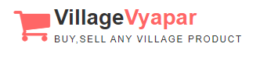
Web-application for,
Village Vyapar
“Buy, Sell and Find just about Village Product (c2c)”

Slide 2
INDEX
No. | Content | Slide No.
1 | Group Information | 3
 | Company Profile | 4
3 | Project Definition | 5
4 | System Development Platform | 6
5 | Admin Panel | 7
6 | Customer Panel | 72
7 | Reports | 114
8 | References | 129

Slide 3
1 | Group Information | 3
 | Company Profile | 4
3 | Project Definition | 5
4 | System Development Platform | 6
5 | Admin Panel | 7
6 | Customer Panel | 72
7 | Reports | 114
8 | References | 129

Slide 4
Group Information :
GROUP NO : 04
Full Name | Enrollment No
Raja Himani Yatin | 205160694004
Chauhan Zeel Jitendrakumar | 205160694009
Parmar Devansh Rajeshbhai | 205160694023
Lashkari Parth Ashokbhai | 205160694029
Internal Faculty : :
Prof. Alka Patel

Slide 5
1
INTRODUCTION

Slide 6

Existing System :
Existing system is trading between people through calls,
and middle man therefore it is limited geographically.

Slide 7


Need for the New System :
The geographical limitation stops the business from growing and hence a lot of products do not get much attention.
It is difficult to account for the sales.
Cost of product is increased as middle man is included also
there is thin profit margin

Slide 8
Objective of New System :
This system allows to directly communicate via chat board so customer and
seller can negotiate on suitable price.
To increase the sales of the current small scale village businesses.
To provide multiple source of the same products which ensures that the
customer gets the desired quality product.
Cost of product is reduced as middle man is eliminated.
Customer can view products in any native language.

Slide 9

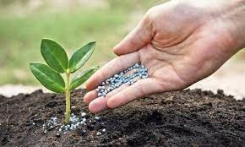
Project Definition :
This project is aimed at developing a web application that depicts online shopping of village products such as
food, Animals feed, Handicraft etc.
This web application also allows customer to
sell the product and others can purchase or vice versa
(i.e. Customer to Customer).
It provides a communication medium via chat board.

Slide 10




Core Components :
Admin
Customer
Visitor

Slide 11
Admin
Login
Manage Profile
Manage Customers
Manage Category & Sub category
Manage Products
Manage Inquiry
Manage Feedback
Generate Reports

Slide 12
Customer
Login
Manage Profile
Search Rural Product
View Categories & Sub Categories
View Rural Product in multiple language
Chat with Seller/Buyer
Inquiry
Feedback
Manage Inquiry
Manage Product
Manage Wishlist

Slide 13
Visitor
Registration
Search Rural Product
View Rural Product
View Feedback & Rating

Slide 14
Project Profile :

Slide 15
Assumptions & Constraint :

Slide 16
Advantages of Proposed System :

Slide 17
Disadvantage of Proposed System :

Slide 18
2
Requirement Determination & Analysis

Slide 19
3
Screen-shots (Customer)

Slide 20

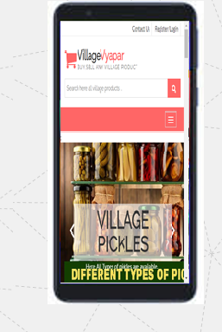
Requirement Determination

Slide 21
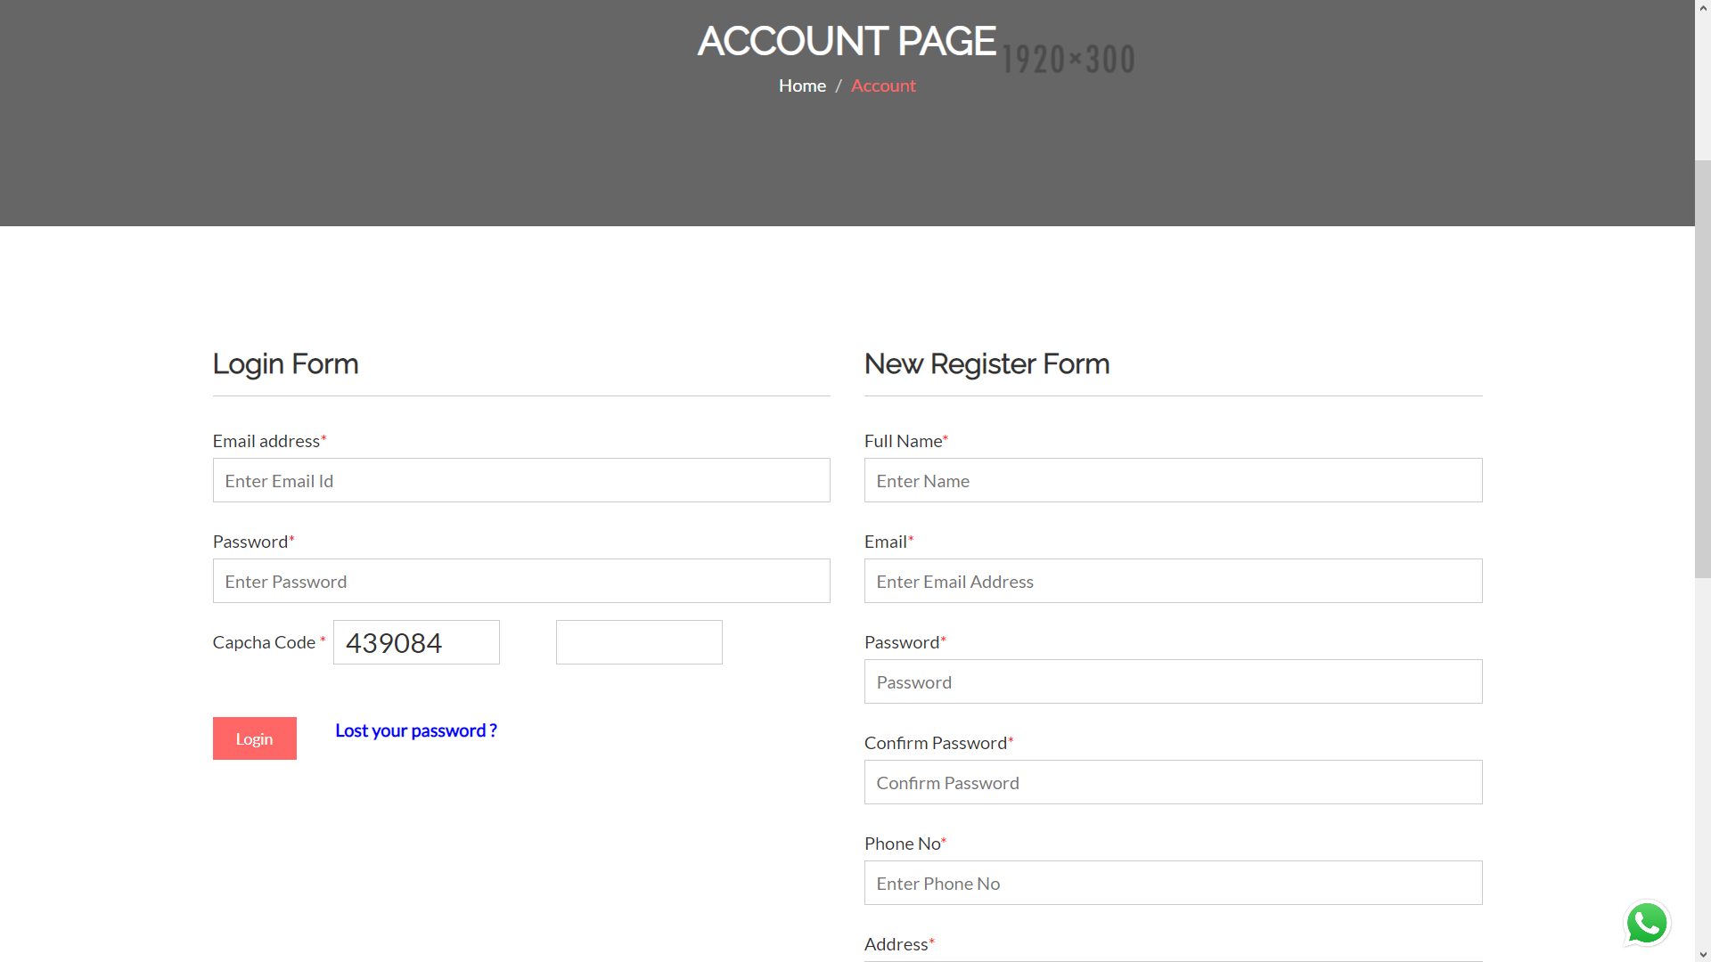
Login and Registration page

Slide 22
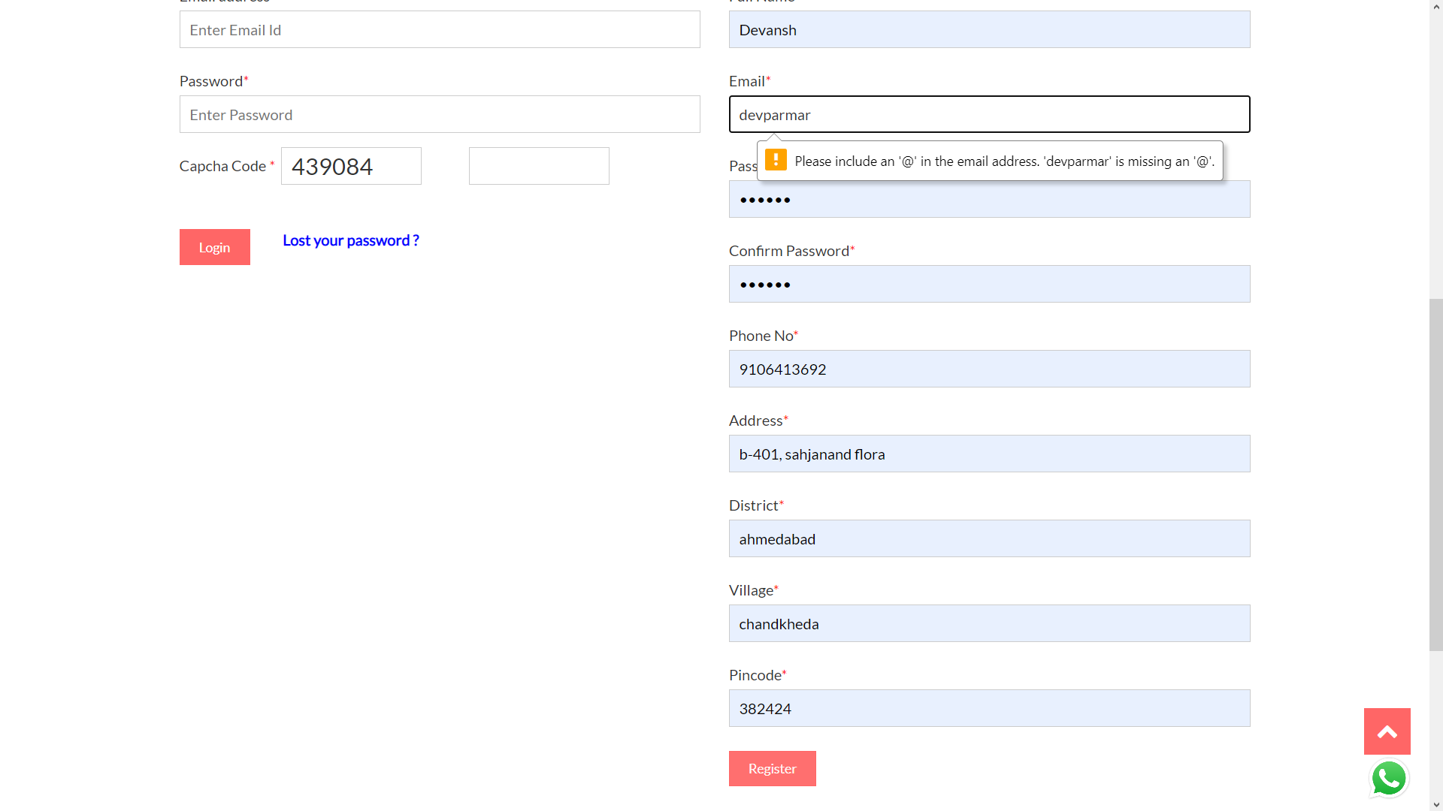
Registration with invalid credentials

Slide 23
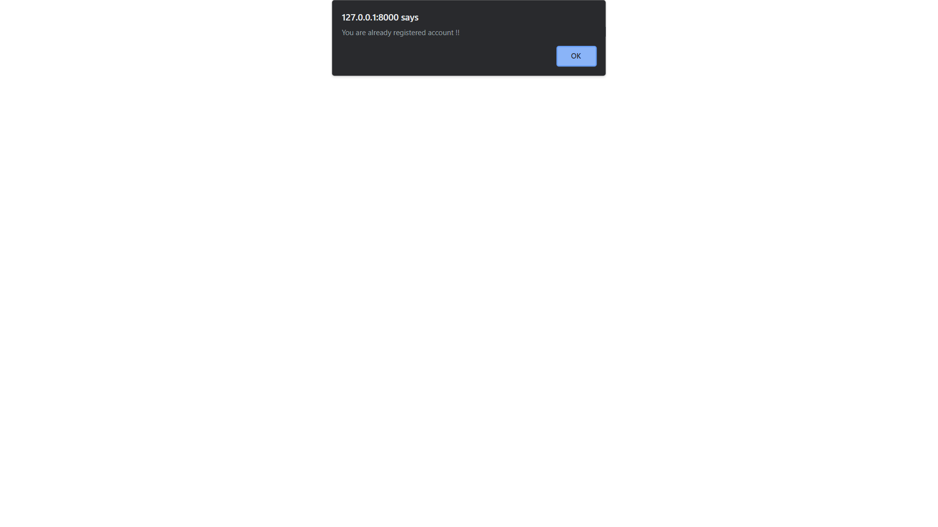
Registration with existing email

Slide 24

OTP sent at email on New Registration

Slide 25
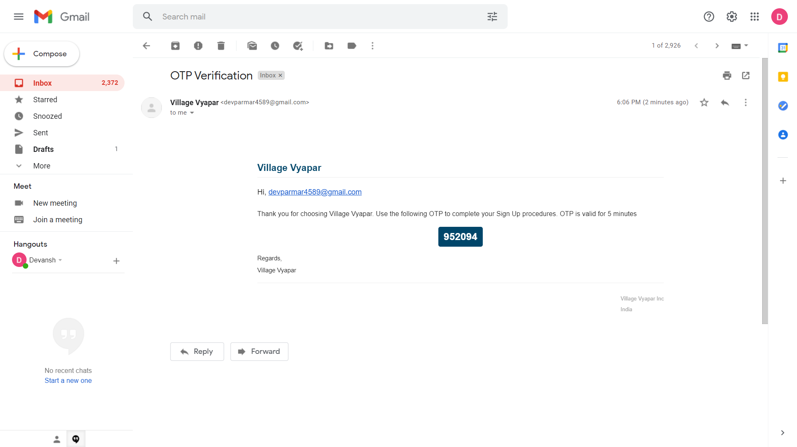
OTP sent at email on New Registration

Slide 26
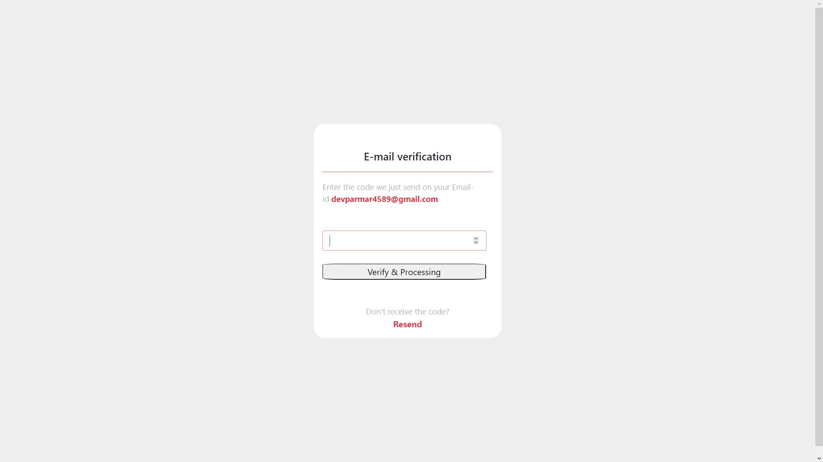
Confirm OTP sent at email

Slide 27

Homepage after Registration and login

Slide 28

Login with invalid credentials

Slide 29
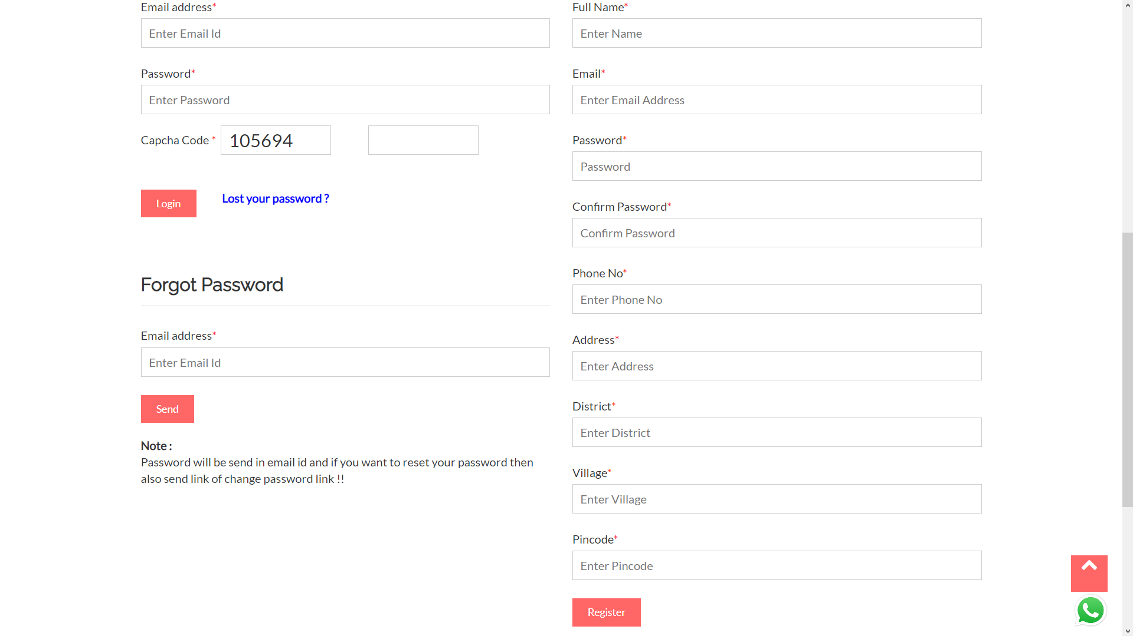
Forgot password

Slide 30

Lost password sent at email address

Slide 31
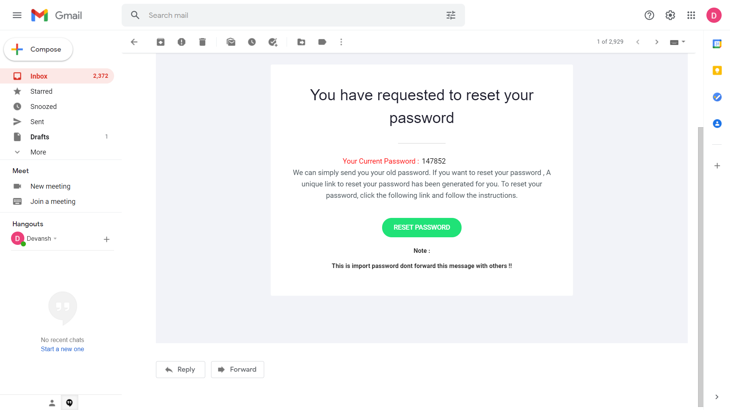
Email sent for lost password

Slide 32

Welcome page after login

Slide 33

Welcome page

Slide 34
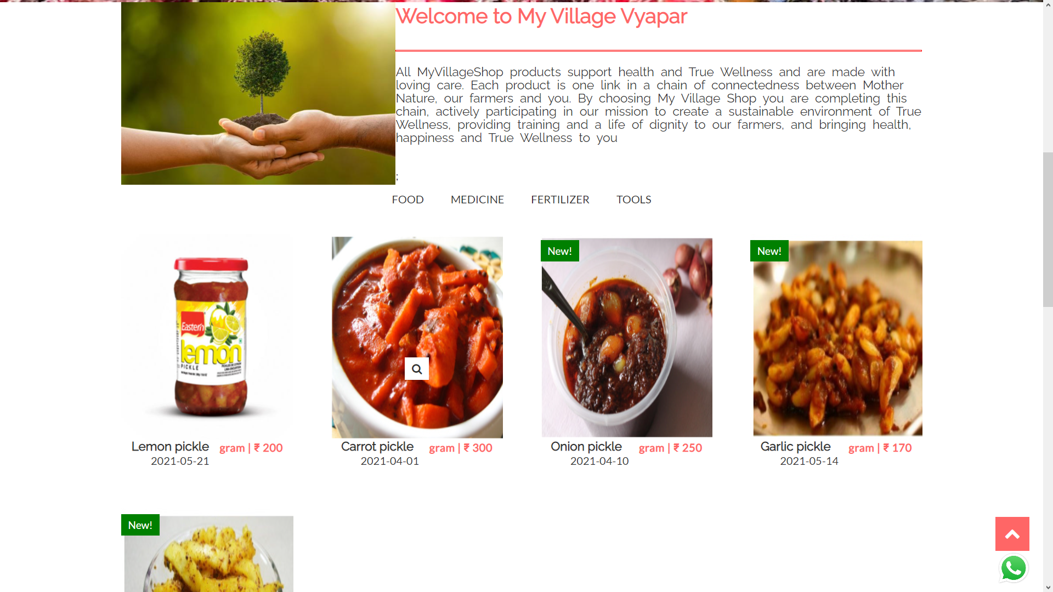
Welcome page

Slide 35
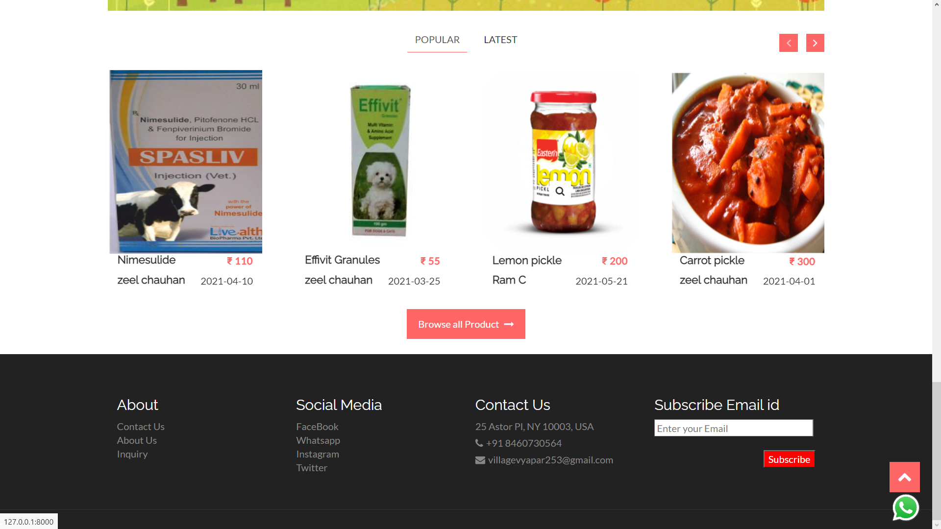
Welcome page Popular products

Slide 36
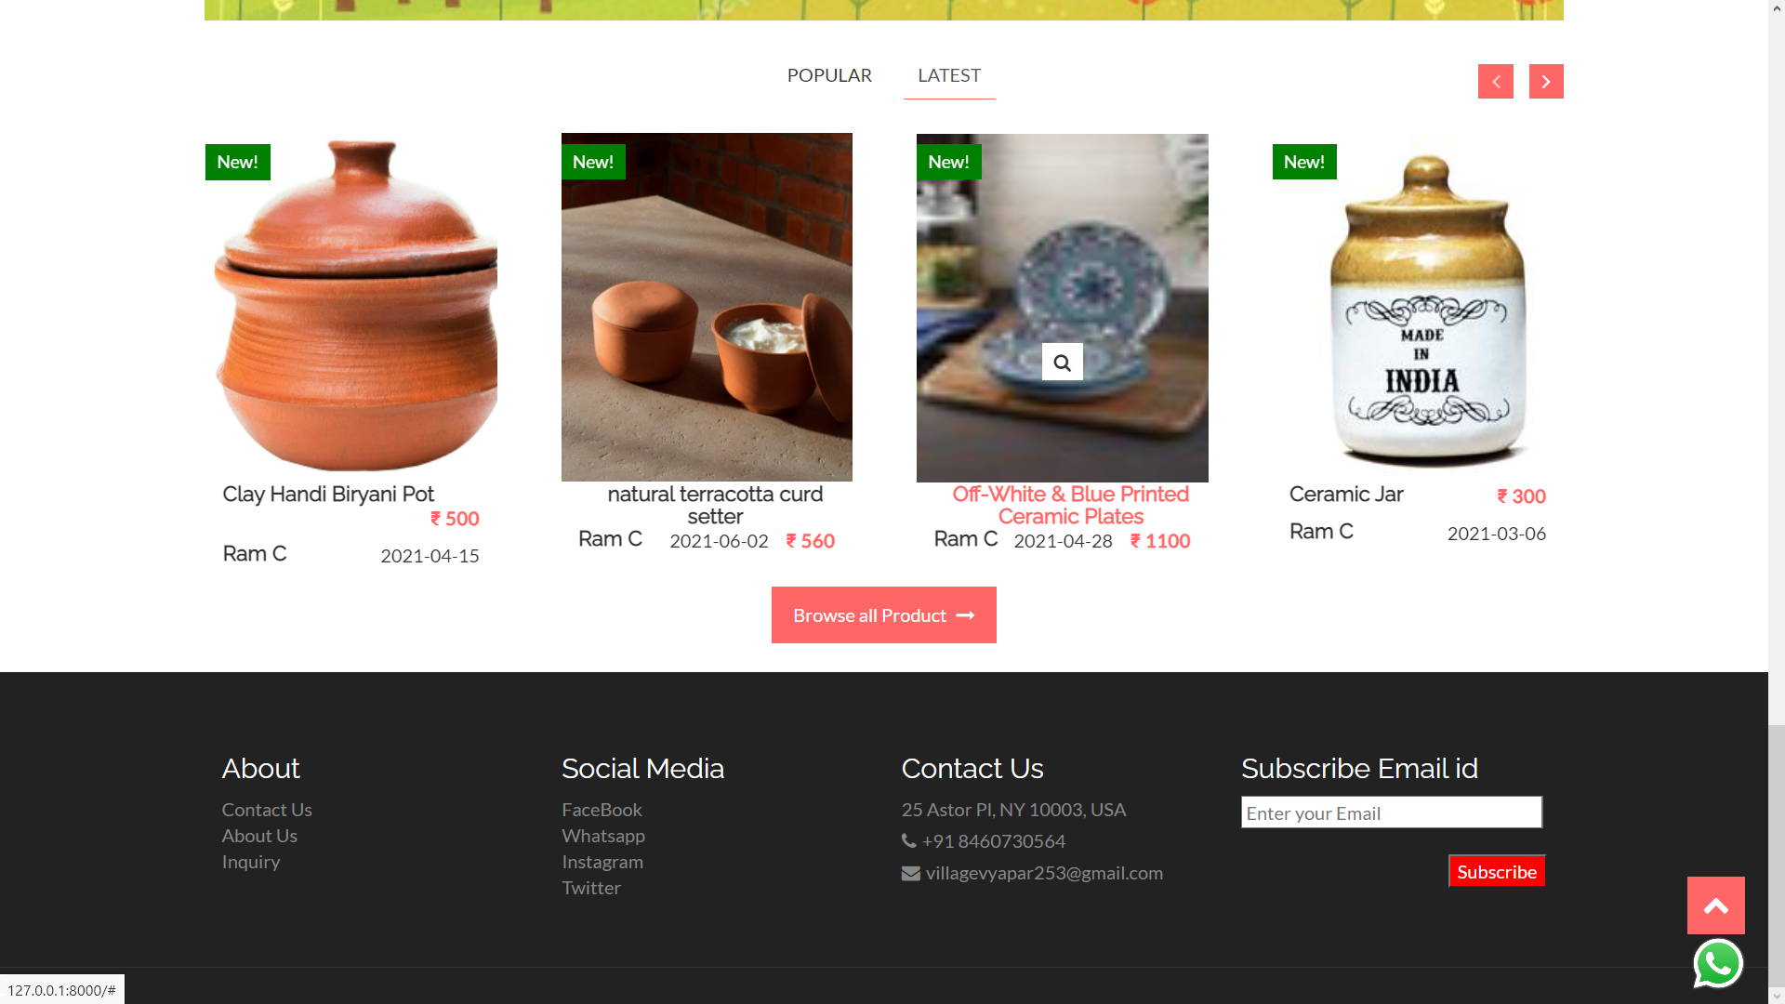
Welcome page Latest products

Slide 37
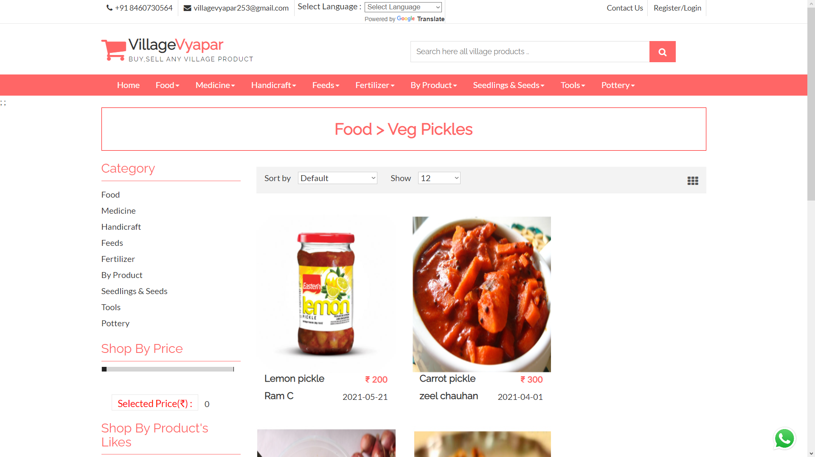
Products within subcategories

Slide 38
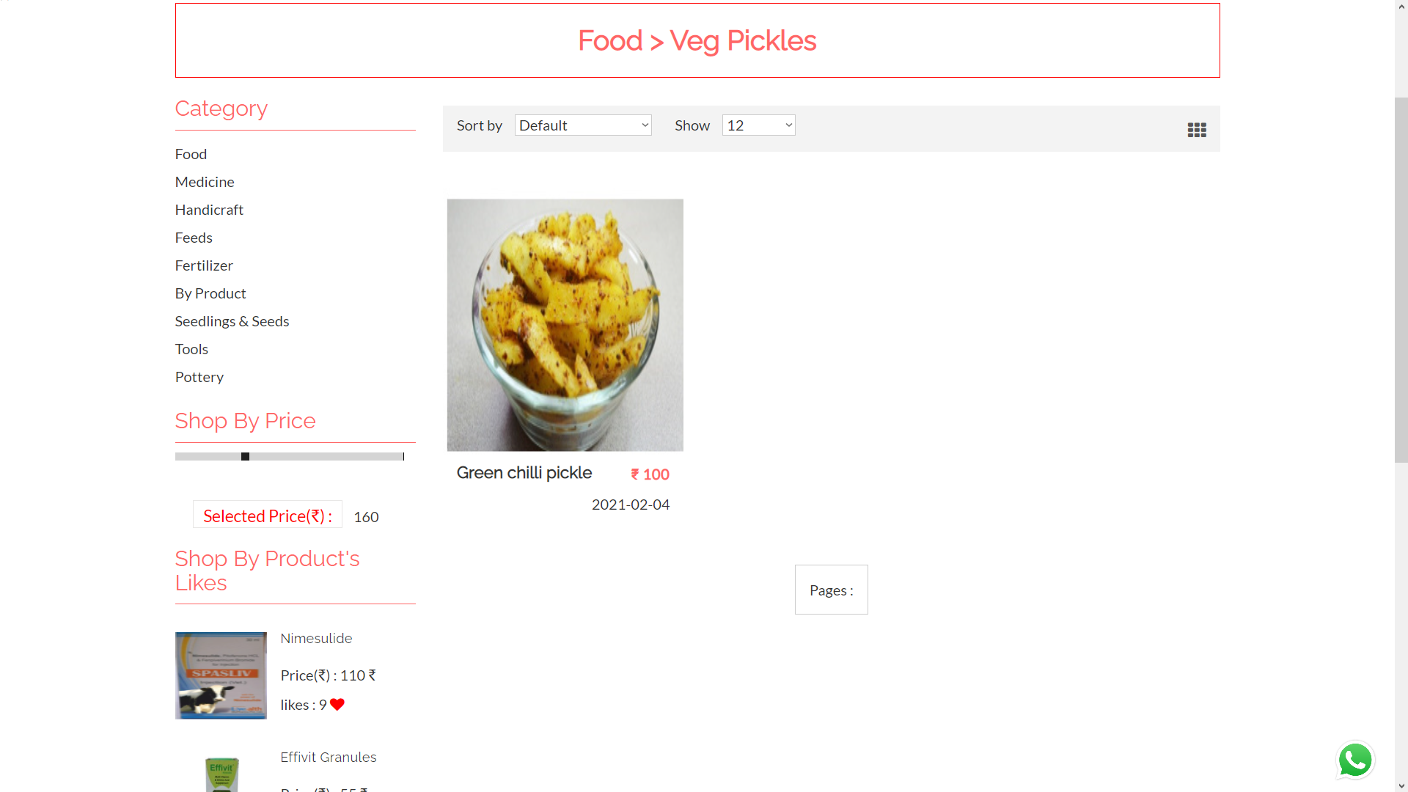
Products limited with price

Slide 39
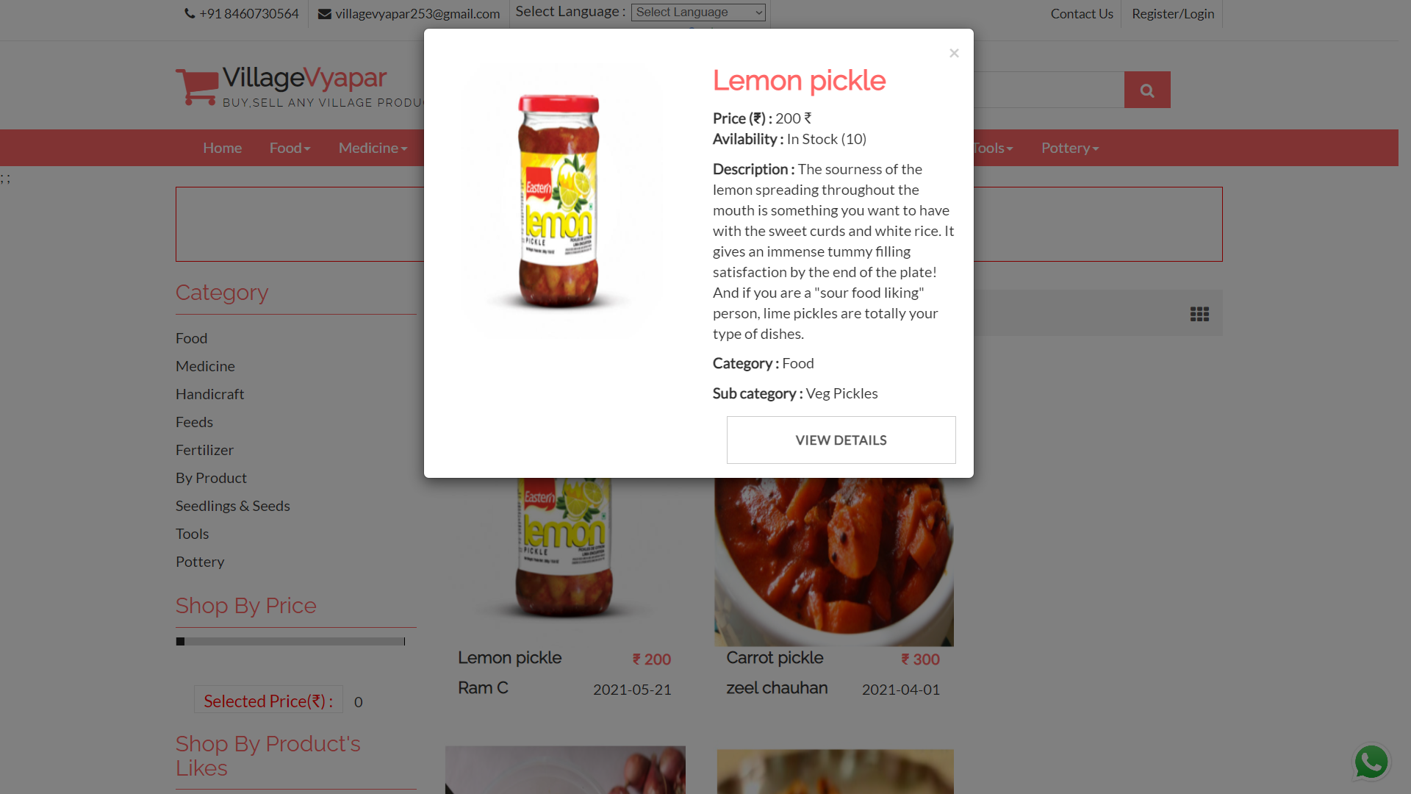
Product detail dialogue box

Slide 40
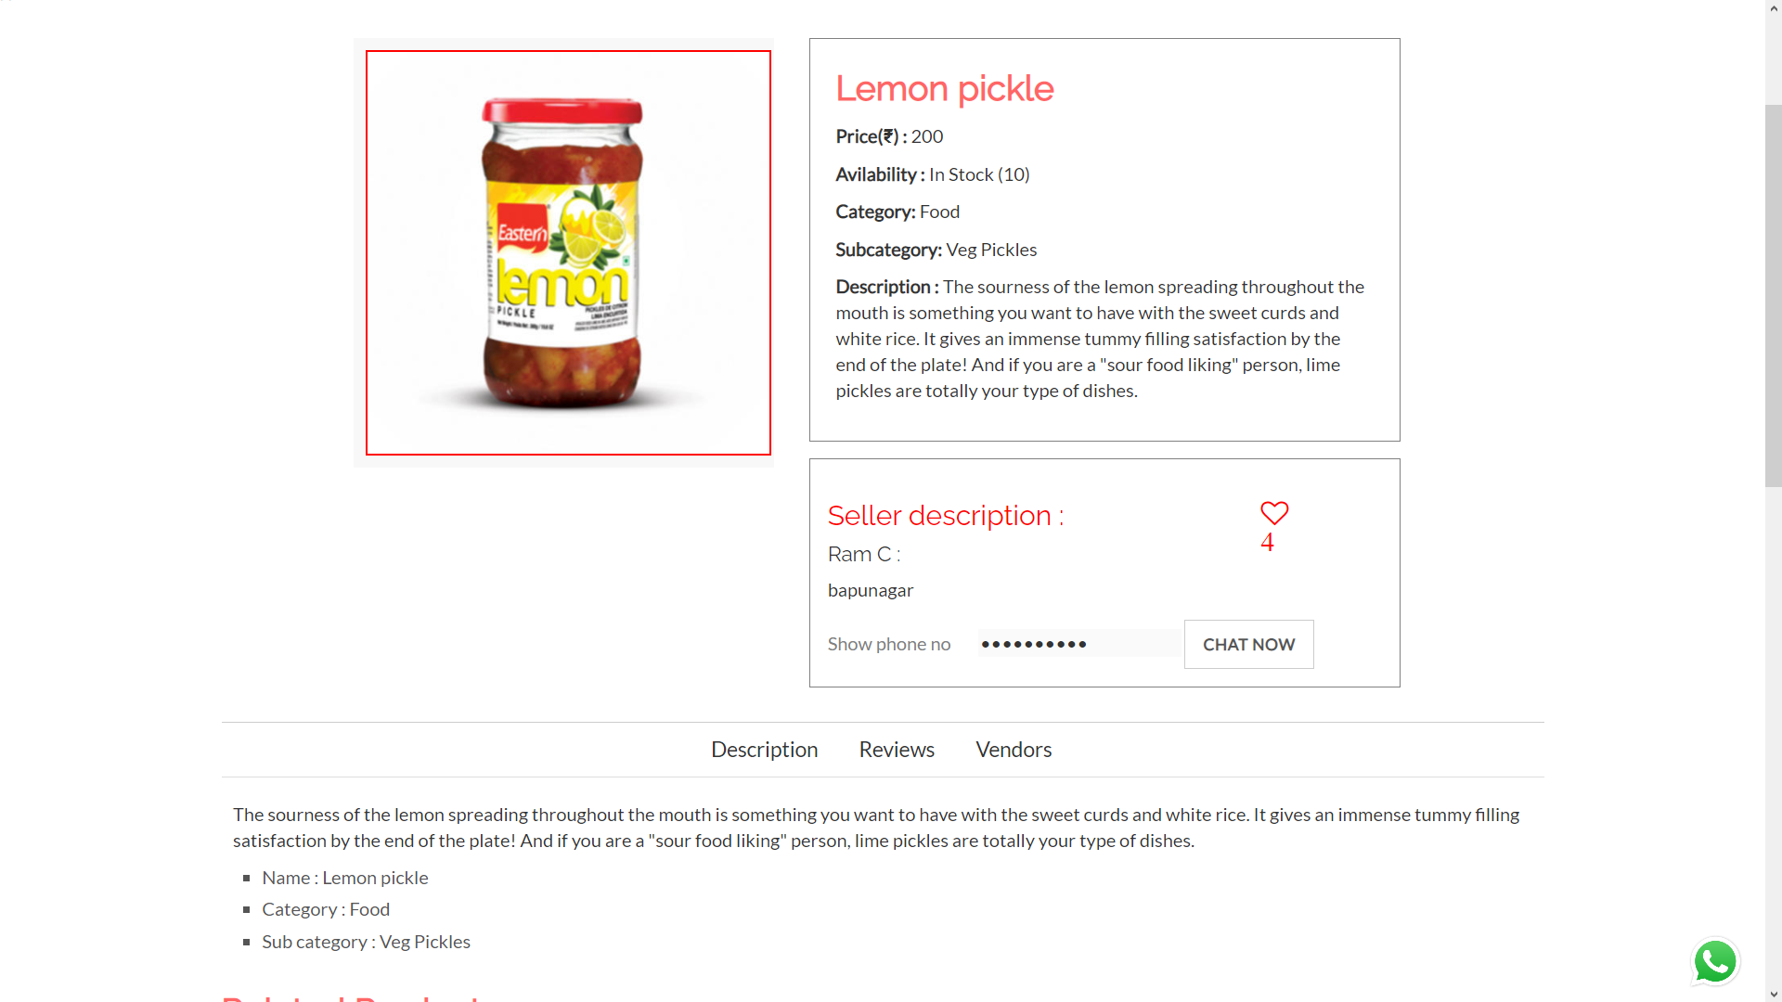
Product details

Slide 41
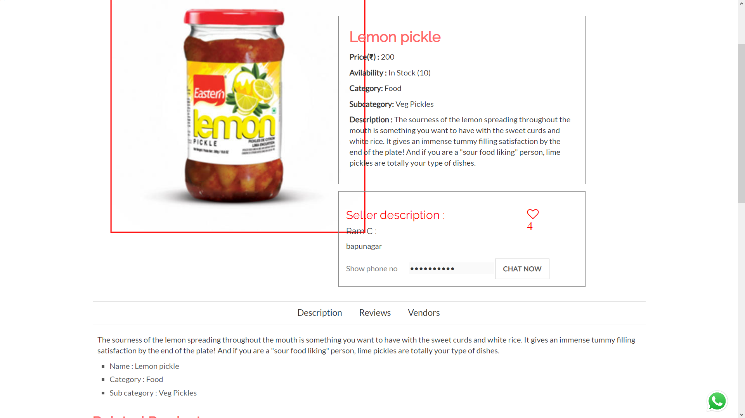
Product image zoomed

Slide 42
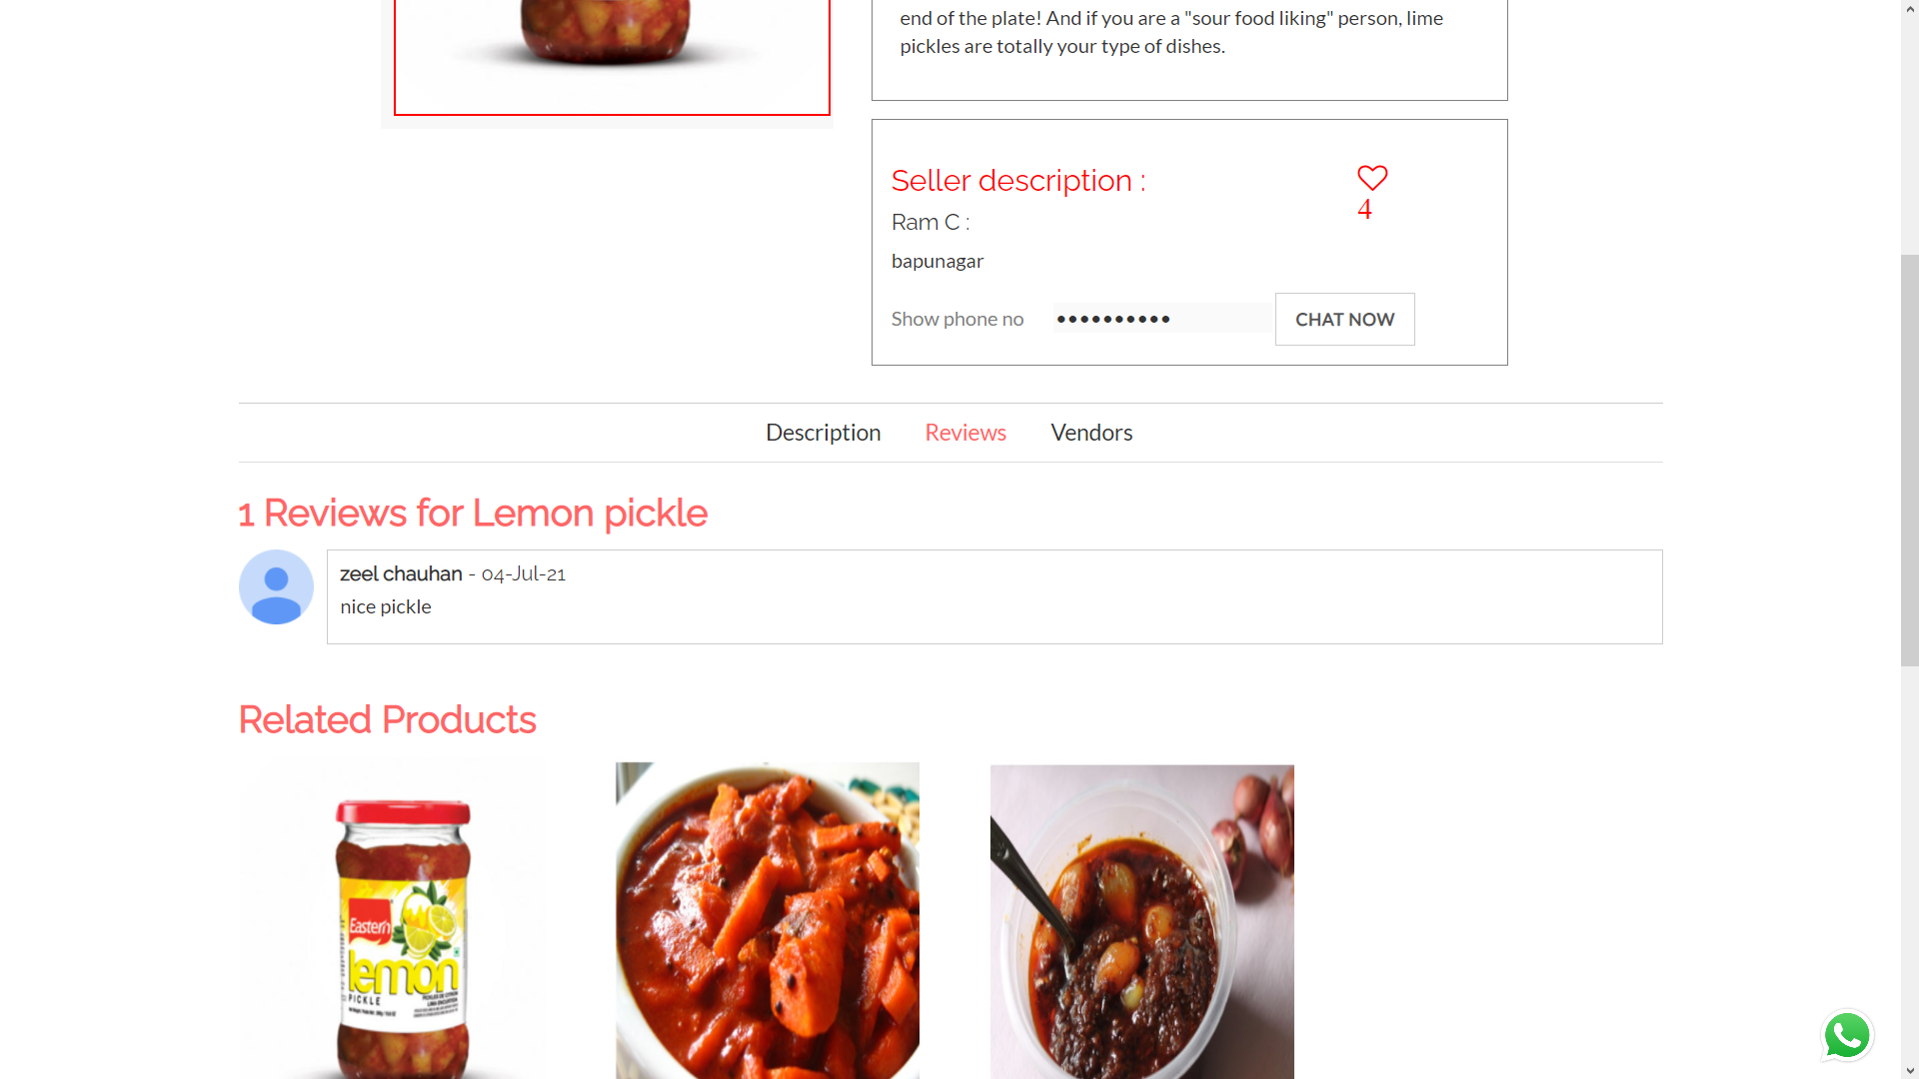
Product review

Slide 43
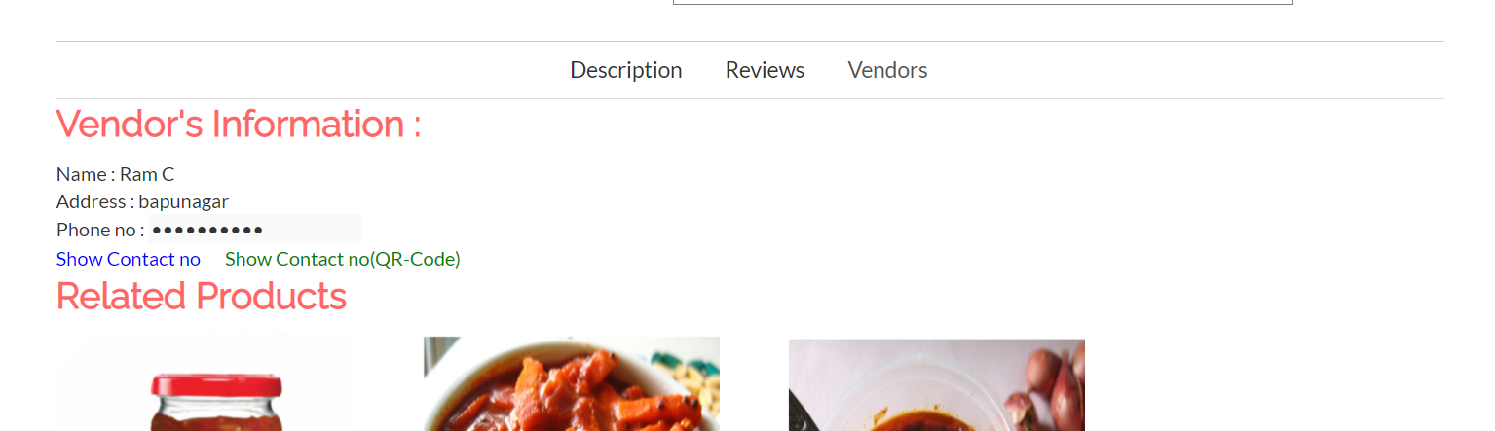
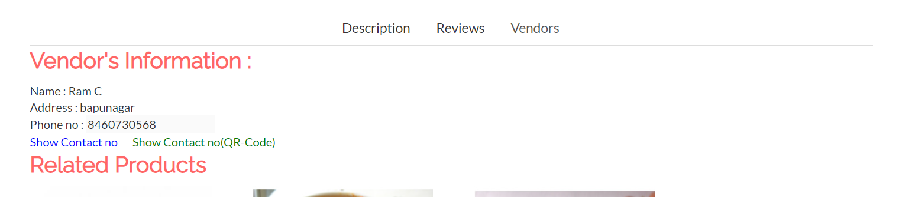
Vendor info 1

Slide 44
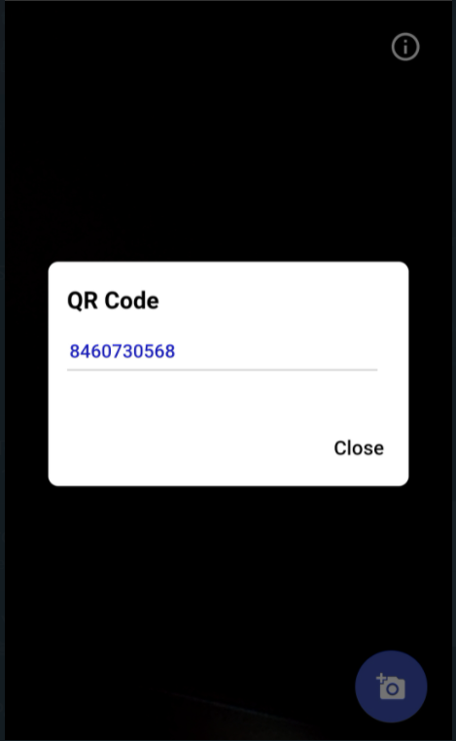
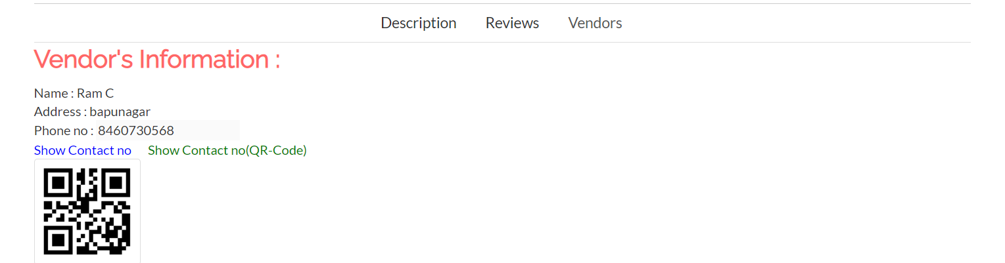
Vendor info 2

Slide 45
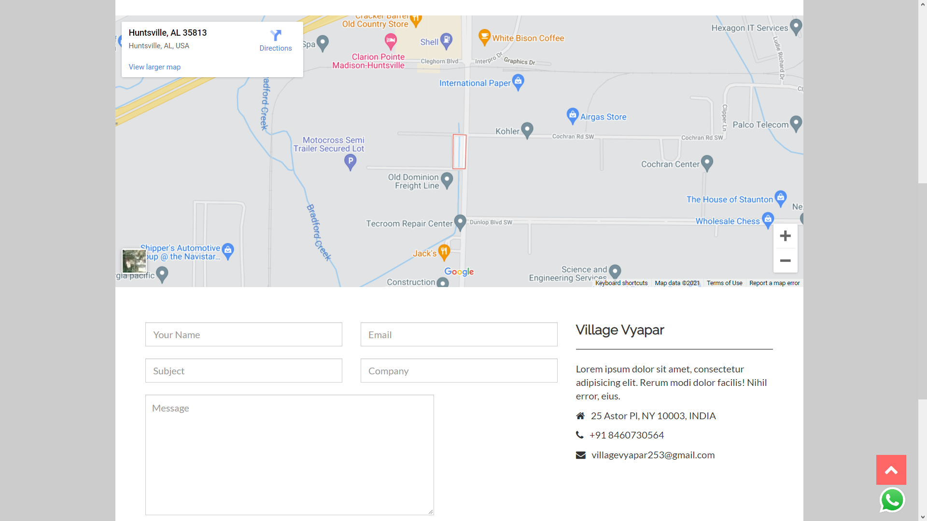
Contact us

Slide 46
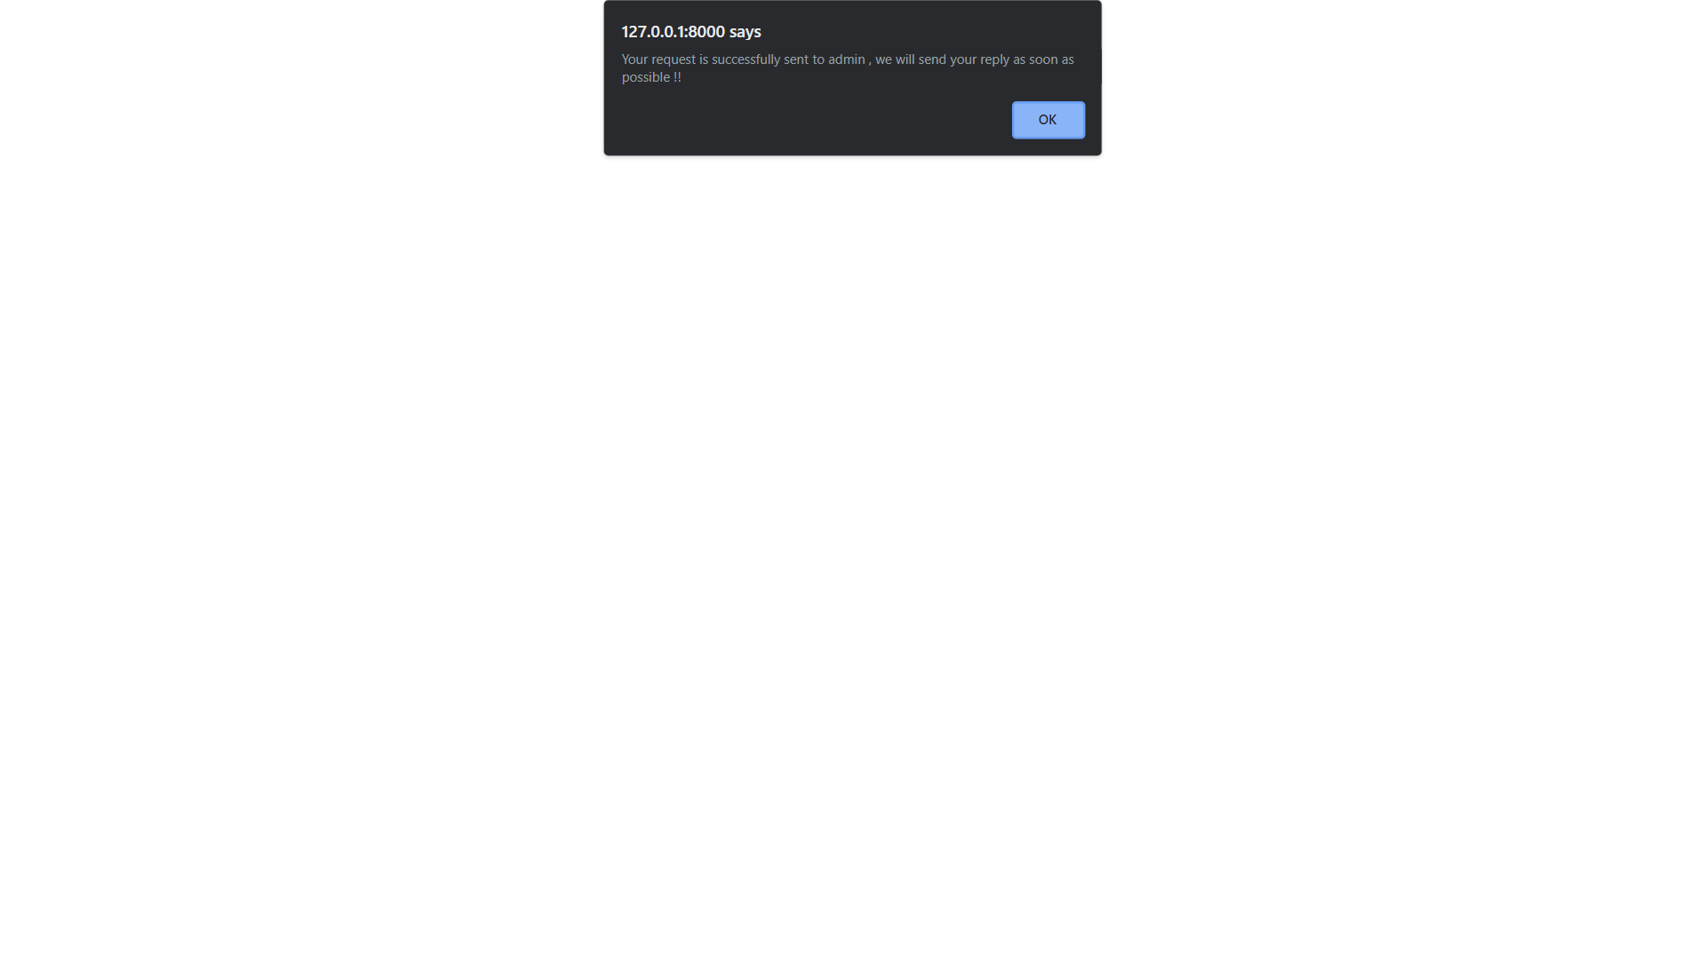
Inquiry asked

Slide 47
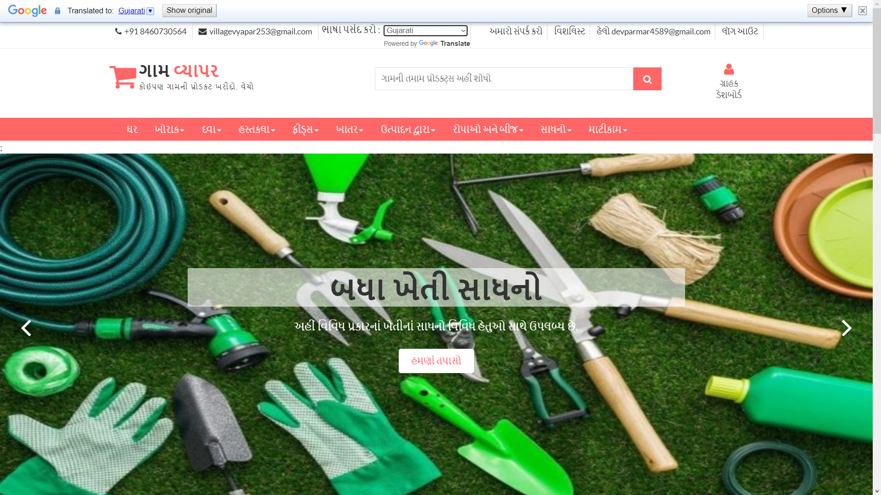
Language changes

Slide 48
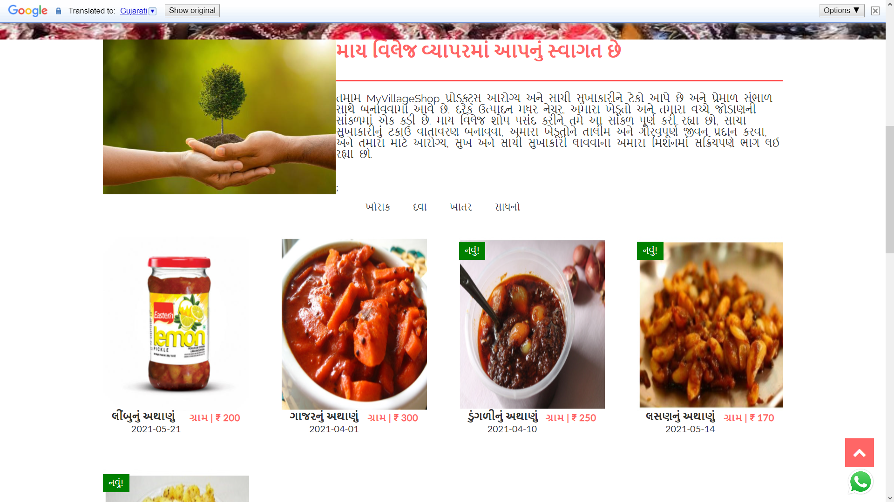
Language changes

Slide 49
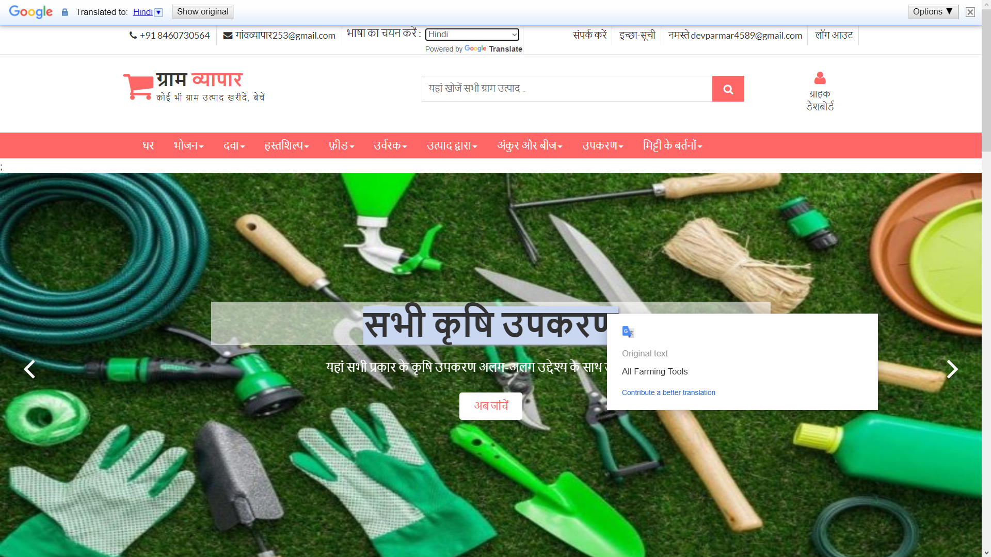
Language changes

Slide 50
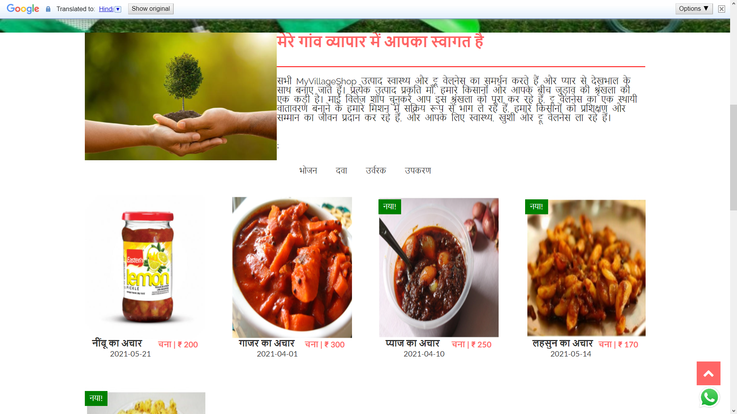
Language changes

Slide 51
Login

Slide 52
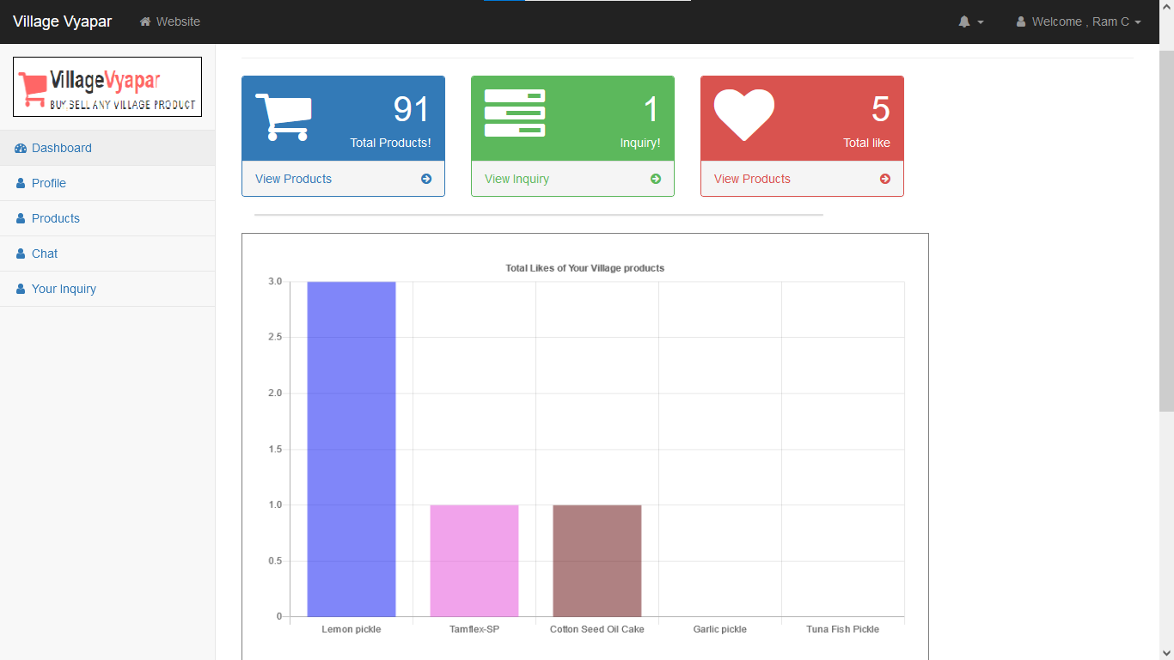
Customer Dashboard

Slide 53
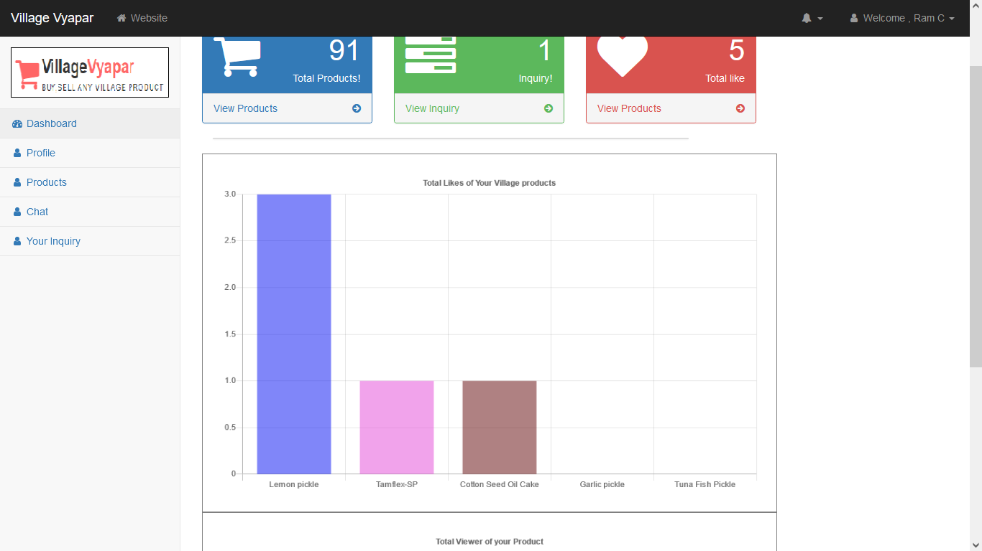
Total Likes of customer products

Slide 54
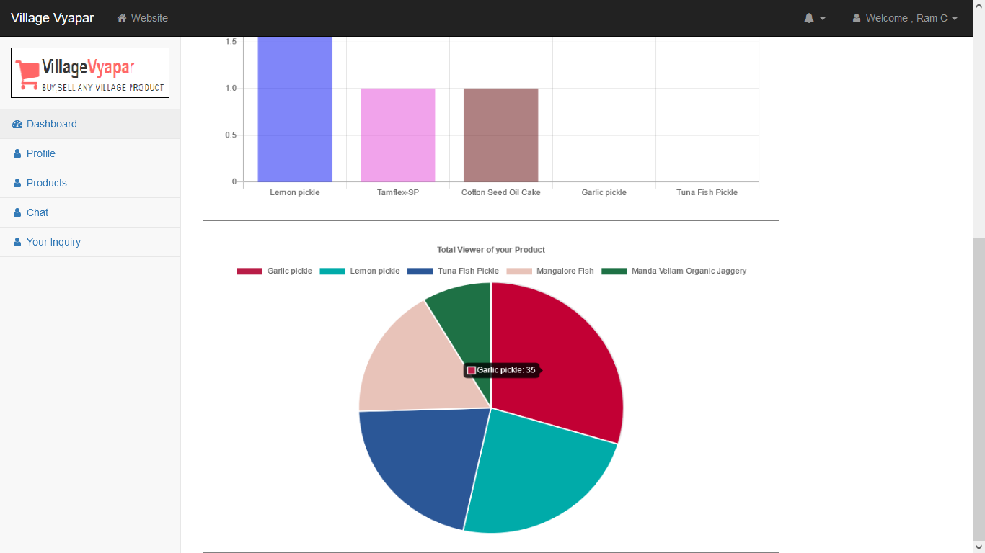
Total Viewer of customer products

Slide 55
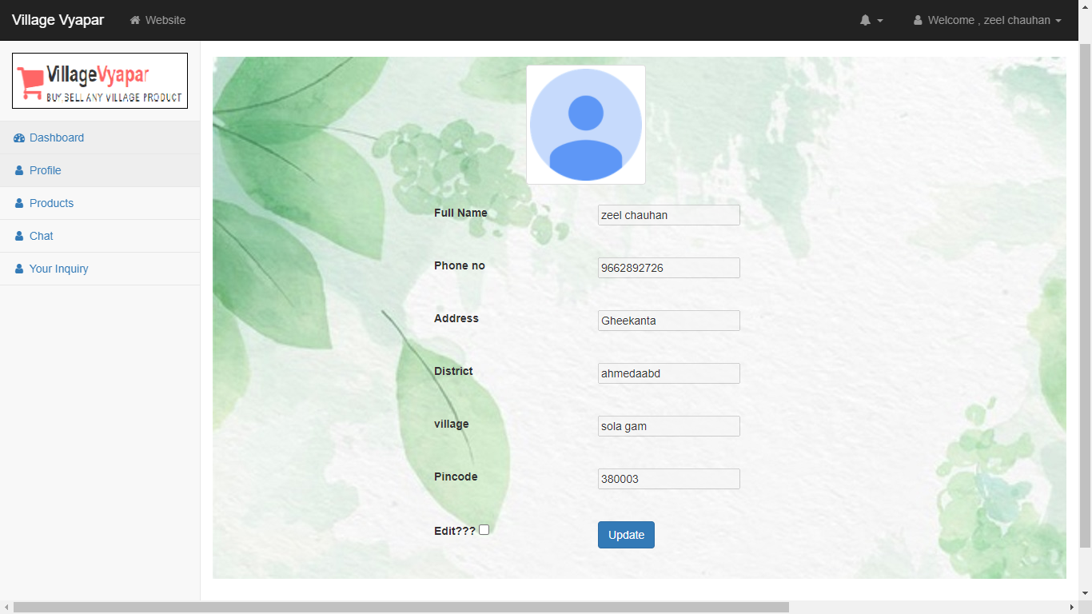
Customer Profile

Slide 56
Update Customer Profile

Slide 57
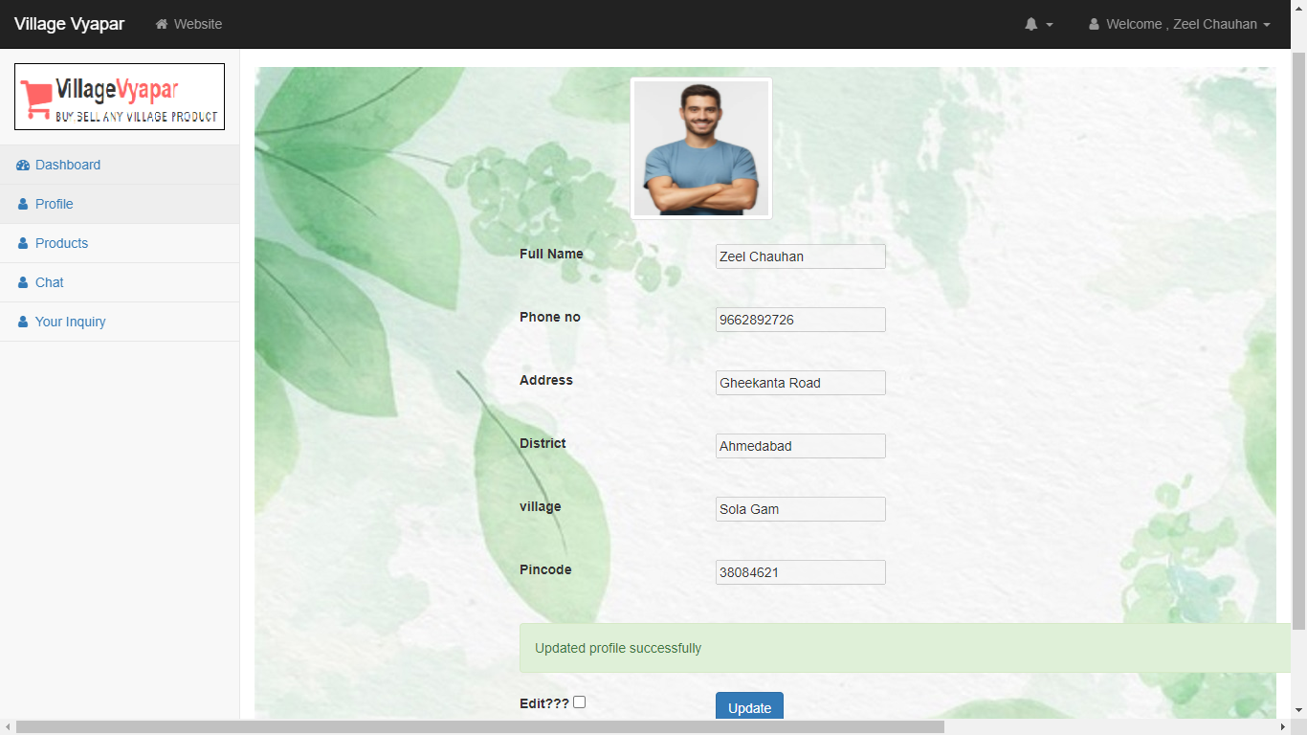

Slide 58
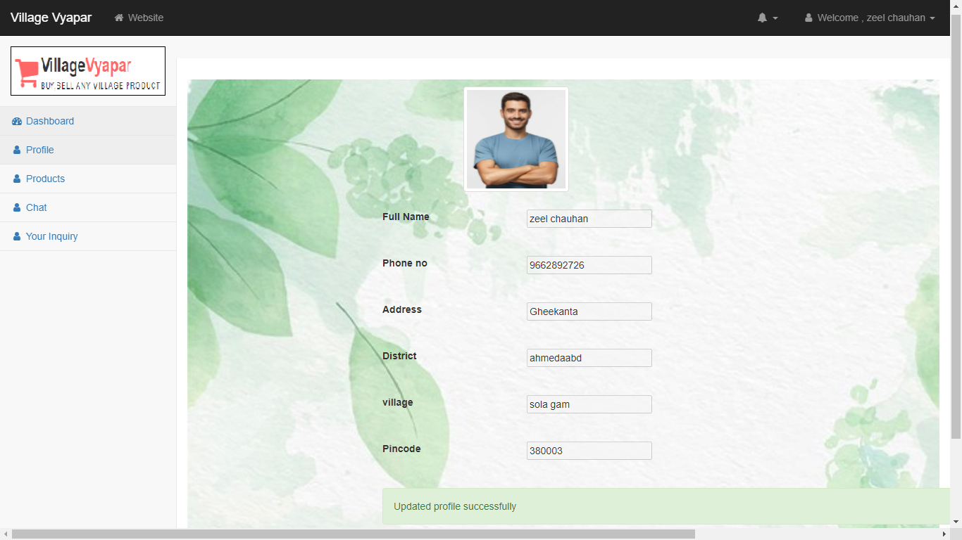

Slide 59
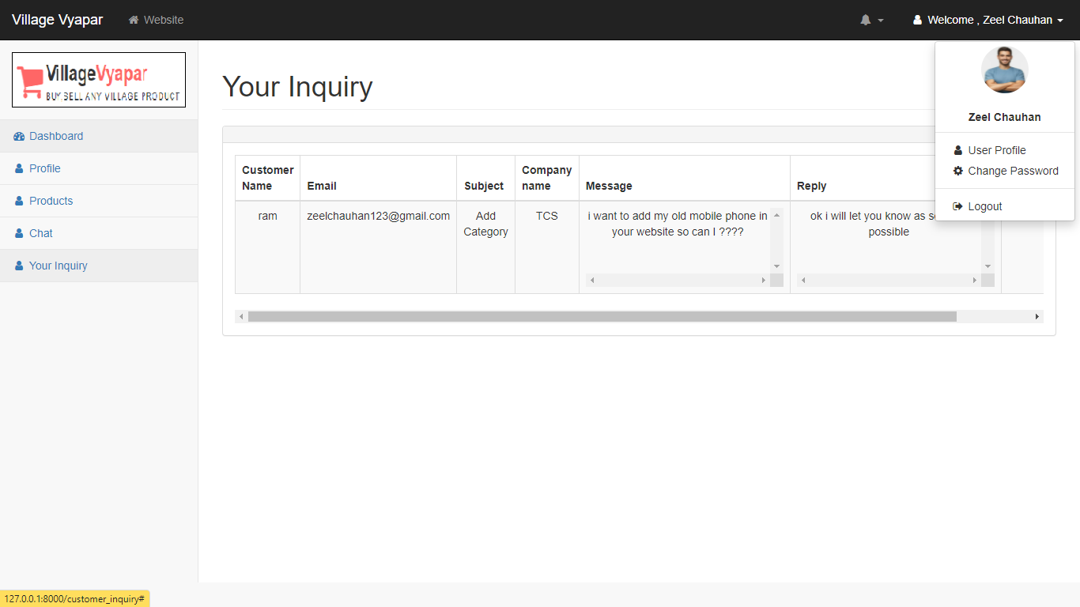

Slide 60
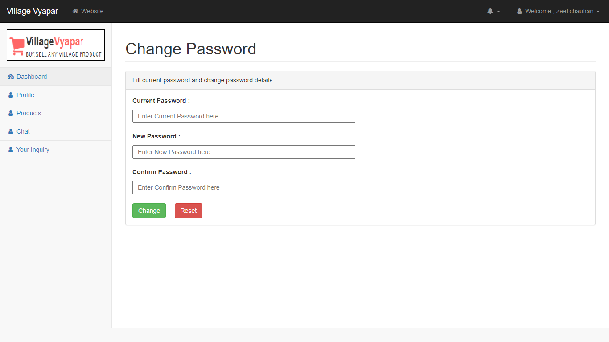
Change Password

Slide 61
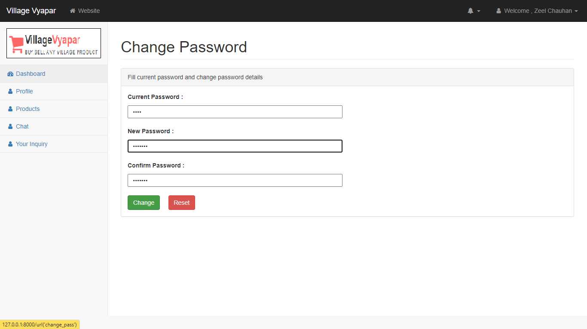

Slide 62
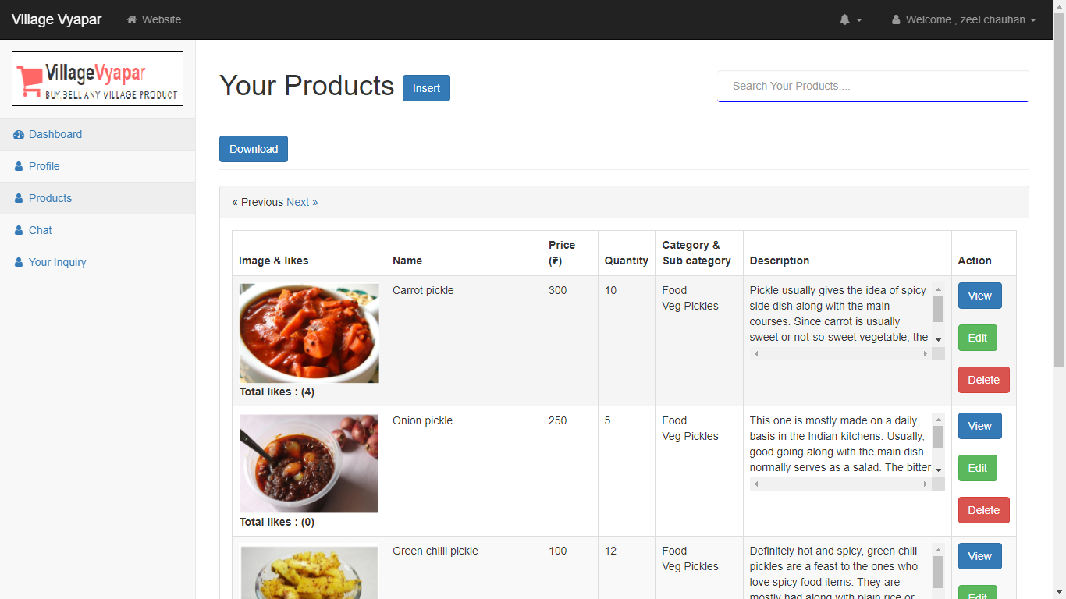
View Products

Slide 63
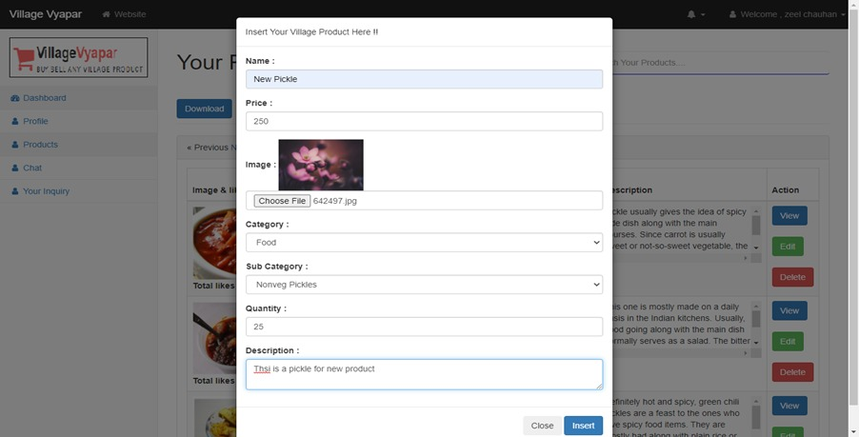
Insert Product

Slide 64
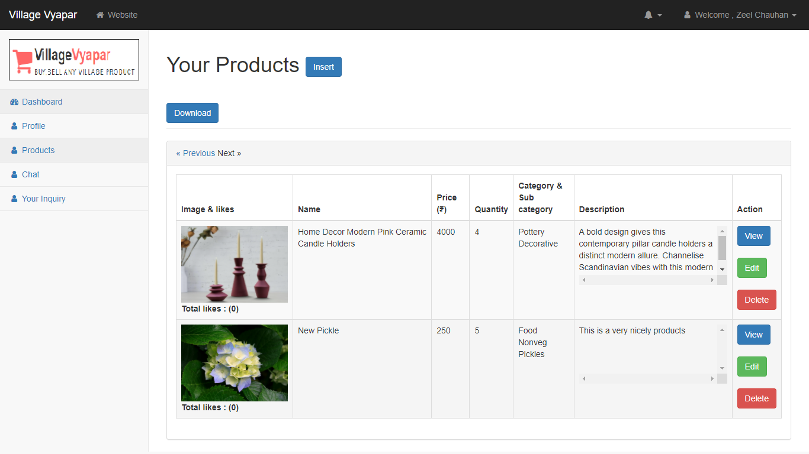
Product Inserted

Slide 65
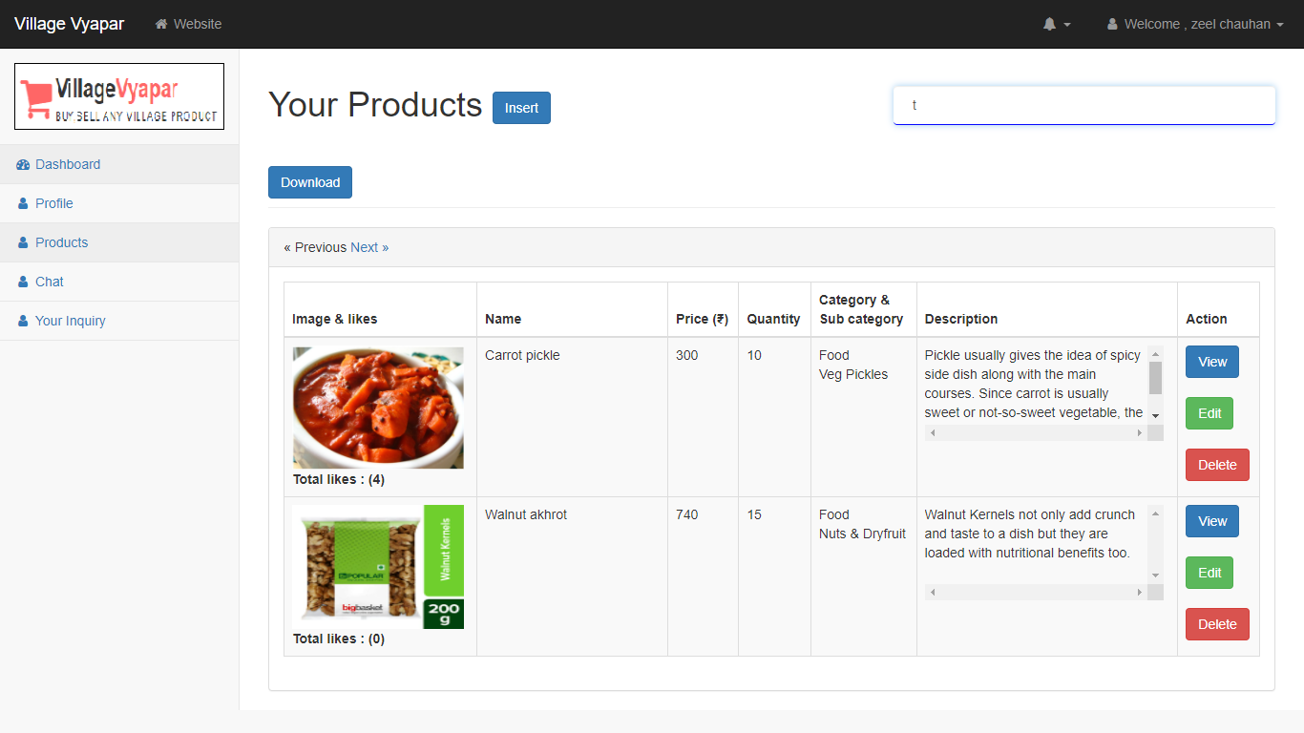
Search Products

Slide 66
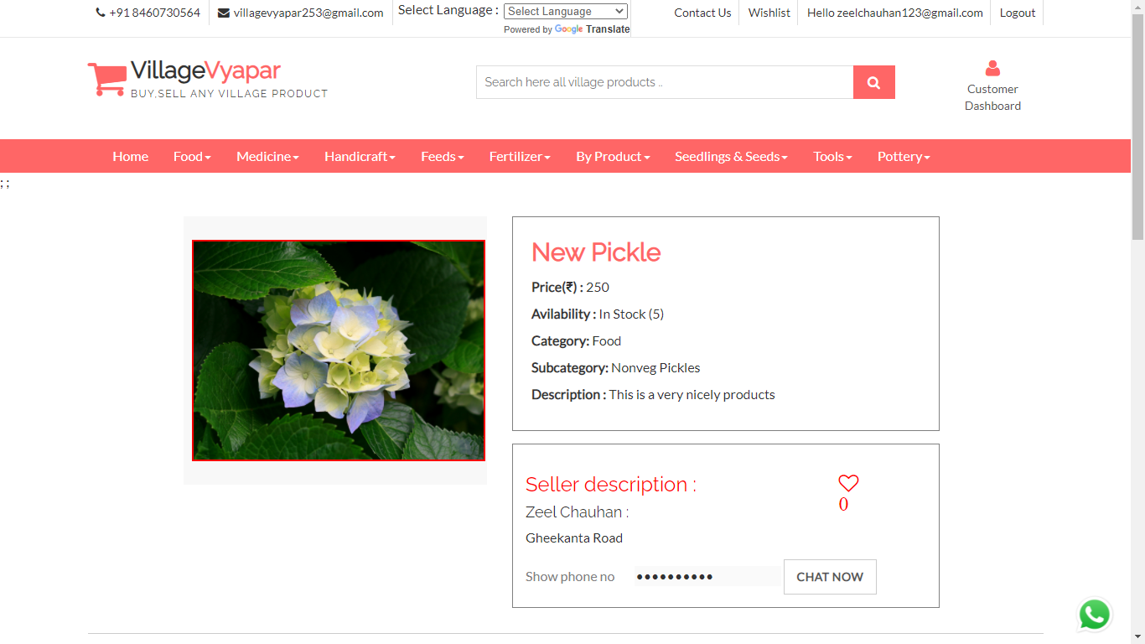
View Product

Slide 67
Edit Product details

Slide 68
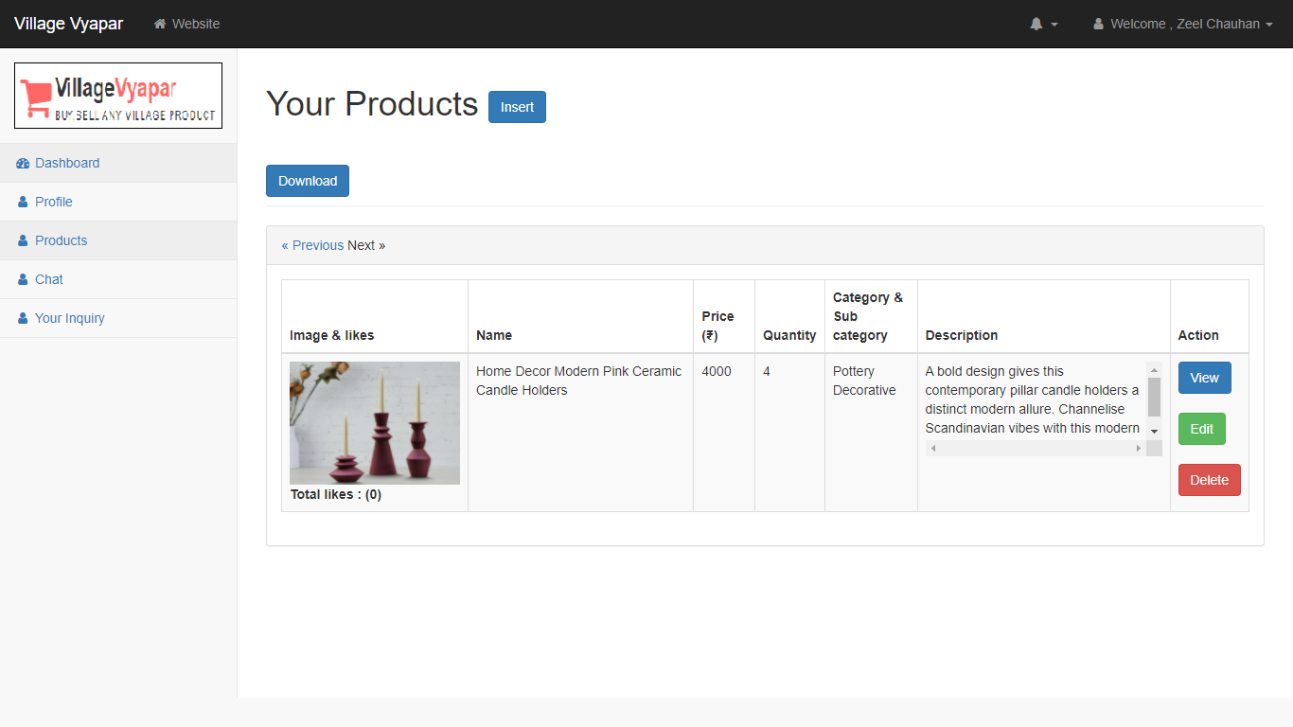
Delete Product

Slide 69
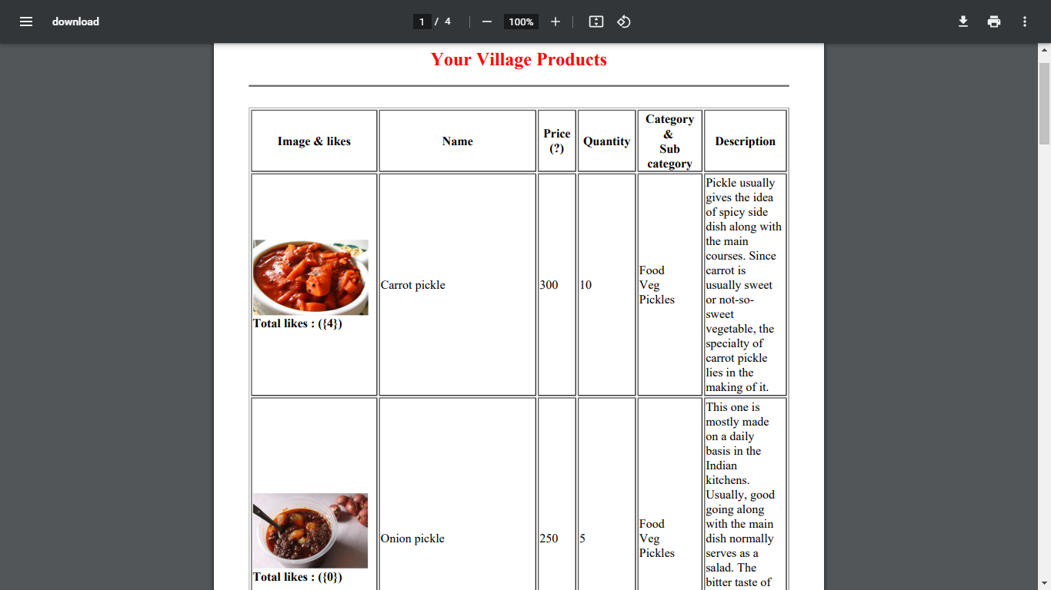
Download Product (Pdf)

Slide 70
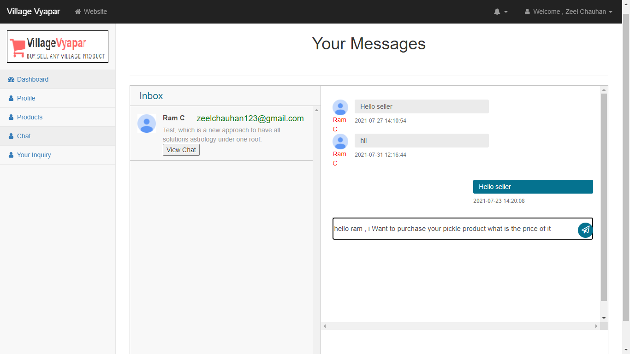
Chat bot

Slide 71
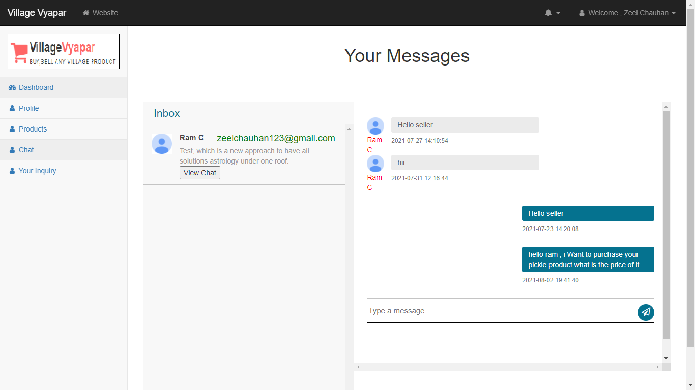

Slide 72
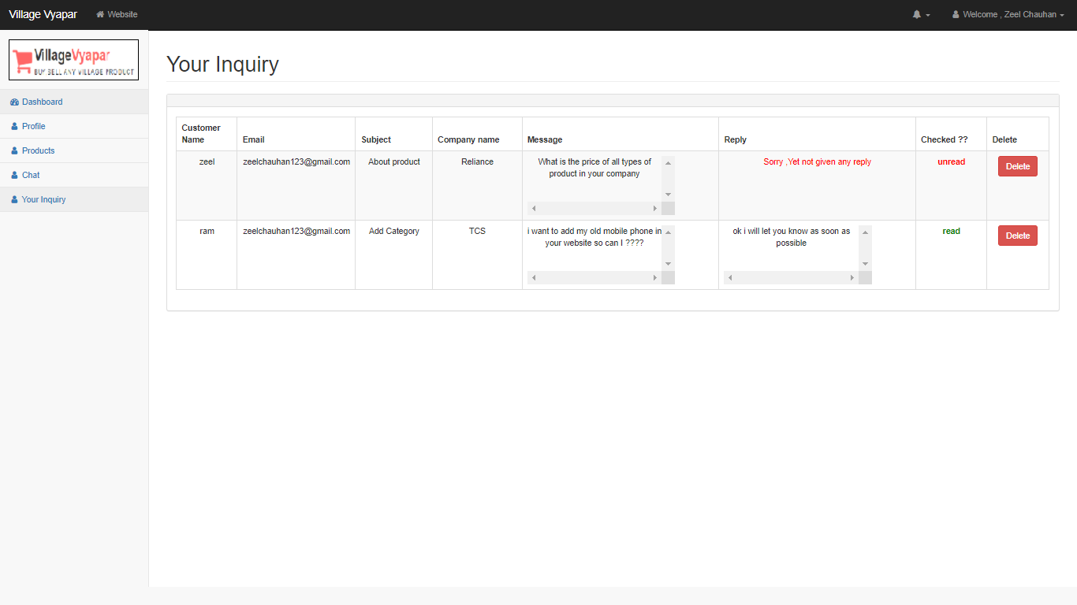
Inquiry

Slide 73
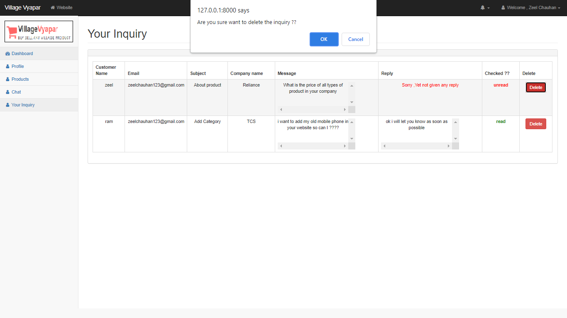
Delete Inquiry

Slide 74
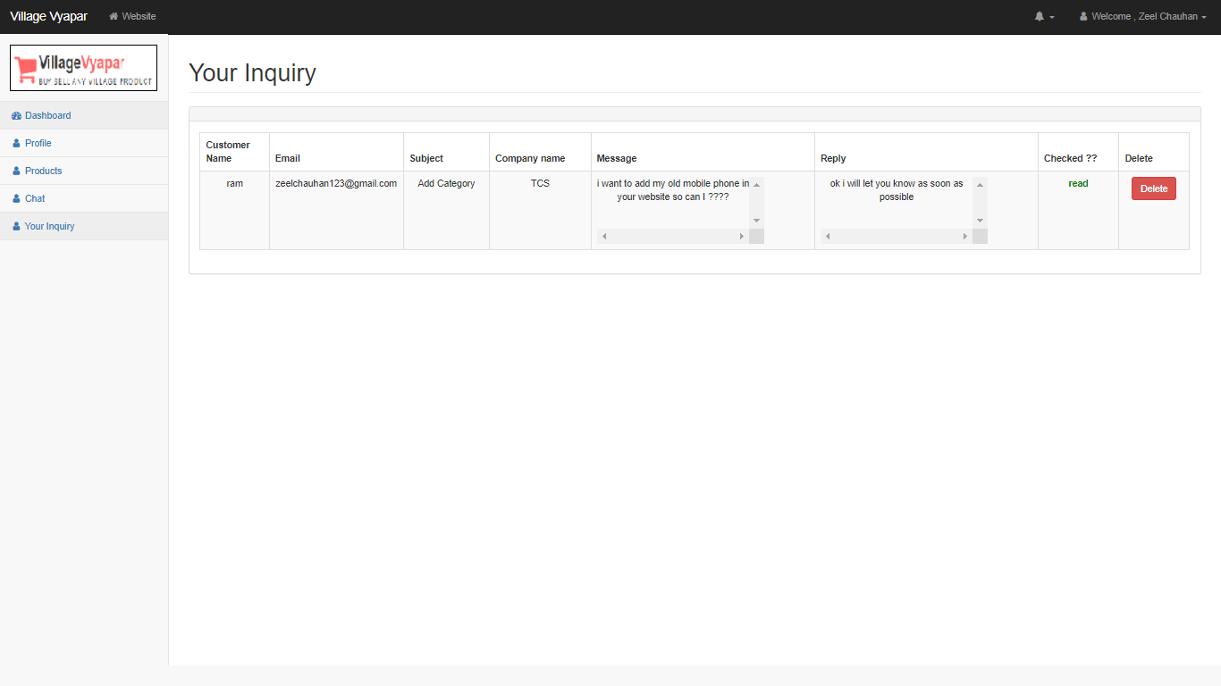

Slide 75
3
Screen-shots (Admin)

Slide 76

Admin-login Page

Slide 77

Validate Credential

Slide 78

Invalid Login-credential

Slide 79

After Successful Login -Dashboard

Slide 80

Show Product detail menu

Slide 81

Show Categories

Slide 82

Add Category

Slide 83

After Add New Category

Slide 84

Edit Category

Slide 85

After Successfully Edit Category

Slide 86

Delete Category

Slide 87

After Delete Sample Category

Slide 88

Show Sub-Category

Slide 89

Add Sub-Category

Slide 90

After Add New Sub-Category

Slide 91

Delete Sub-Category

Slide 92

After Delete Sub-Category

Slide 93

Shows Products

Slide 94

View Product

Slide 95

Delete Sample Product

Slide 96

After Delete Sample Product

Slide 97

Search Product

Slide 98

Show User-details Menu

Slide 99

View customer list

Slide 100

Search Customer

Slide 101

View Admin list

Slide 102

Show Inquiry

Slide 103

Reply To An inquiry

Slide 104

After Reply To An inquiry

Slide 105

Show Admin Menu

Slide 106

Edit Admin profile

Slide 107

After Edit Admin Profile

Slide 108

Admin Forgot Password 1

Slide 109

Admin Forgot Password 2

Slide 110

Security Code on Mail

Slide 111

After entering security code and detail

Slide 112

Show Report Menu

Slide 113

Admin Logout

Slide 114
After Logout

Slide 115
3
System Design

Slide 116
Use Case Diagram

Slide 117
Class Diagram

Slide 118
Interaction Diagram

Slide 119
Activity Diagram

Slide 120
Data Dictionary

Slide 121
4
Development

Slide 122
5
Proposed Enhancement

Slide 123
6
Conclusion

Slide 124
7
Bibliography

Slide 125
CONTENTS
1
4
ADD THE SLIDE TITLE HERE
ADD THE SLIDE TITLE HERE
Please add a comment here
Please add a comment here
2
5
ADD THE SLIDE TITLE HERE
ADD THE SLIDE TITLE HERE
Please add a comment here
Please add a comment here
3
6
ADD THE SLIDE TITLE HERE
ADD THE SLIDE TITLE HERE
Please add a comment here
Please add a comment here

Slide 126
1
ADD THE SLIDE TITLE HERE
PLEASE ADD SLIDE SUBTITLE HERE

Slide 127



Please add title in here
ADD
KEY
WORDS
Please add text here, according to the need to adjust the font and font size. Please add text here, according to the need to adjust the font and font size.
Please add text here, according to the need to adjust the font and font size. Please add text here, according to the need to adjust the font and font size.
Please add text here, according to the need to adjust the font and font size.
ADD
KEY
WORDS
ADD
KEY
WORDS
Please add title in here
Please add text here, according to the need to adjust the font and font size.

Slide 128
Please add title in here
Please add text here, according to the need to adjust the font and font size. Please add text here.
Please add text here, according to the need to adjust the font and font size. Please add text here, according to the need to adjust the font and font size.
1 ADD KEY WORDS
Please add text here, according to the need to adjust the font and font size. Please add text here.
2 ADD KEY WORDS
Please add text here, according to the need to adjust the font and font size. Please add text here.
3 ADD KEY WORDS
Please add text here, according to the need to adjust the font and font size. Please add text here.
4 ADD KEY WORDS
Please add text here, according to the need to adjust the font and font size. Please add text here.
5 ADD KEY WORDS

Slide 129

Please add title in here
Please add text here, according to the need to adjust the font and font size. Please add text here, according to the need to adjust the font and font size.
Please add text here, according to the need to adjust the font and font size. Please add text here, according to the need to adjust the font and font size.
Please add title in here
Please add text here, according to the need to adjust the font and font size. Please add text here.

Slide 130
Please add text here, according to the need to adjust the font and font size, recommended justified form.
64%
50%
75%
ADD KEY WORDS
ADD KEY WORDS
ADD KEY WORDS
Please add text here, according to the need to adjust the font and font size.
Please add text here, according to the need to adjust the font and font size.
Please add text here, according to the need to adjust the font and font size.

Slide 131
ADD KEY WORDS
ADD KEY WORDS
Please add text here, according to the need to adjust the font and font size. Please add text here, according to the need to adjust the font and font size.
Please add text here, according to the need to adjust the font and font size. Please add text here, according to the need to adjust the font and font size.
Please add text here, according to the need to adjust the font and font size. Please add text here, according to the need to adjust the font and font size.
ADD KEY WORDS
Please add text here, according to the need to adjust the font and font size, recommended justified form. Please add text here, according to the need to adjust the font and font size.

Slide 132
10
Please add text here, according to the need to adjust the font and font size.
09
08
07
06
05
04
03
02
01
01
02
03
04
05
06
07
08
09
10
11
12
Please add text here, according to the need to adjust the font and font size, recommended justified form.

Slide 133
ADD KEY WORDS
ADD KEY WORDS
ADD KEY WORDS
Please add text here, according to the need to adjust the font and font size. Please add text here, according to the need to adjust the font and font size.
Please add text here, according to the need to adjust the font and font size. Please add text here, according to the need to adjust the font and font size.
Please add text here, according to the need to adjust the font and font size. Please add text here, according to the need to adjust the font and font size.
Please add text here, according to the need to adjust the font and font size. Please add text here, according to the need to adjust the font and font size.

Slide 134


Please add text here, according to the need to adjust the font and font size. Please add text here, according to the need to adjust the font and font size.
Please add text here, according to the need to adjust the font and font size. Please add text here, according to the need to adjust the font and font size.
Please add text here, according to the need to adjust the font and font size. Please add text here, according to the need to adjust the font and font size. Please add text here, according to the need to adjust the font and font size. Please add text here, according to the need to adjust the font and font size.

Slide 135
Please add title in here
Please add text here, according to the need to adjust the font and font size.
000T
000T
000T
000T
000T
000T
000T
000T
000T
000T
000T
000T
01
02
03
04
05
06
07
08
09
10
11
12
Please add text here, according to the need to adjust the font and font size. Please add text here, according to the need to adjust the font and font size.

Slide 136
Please add text here, according to the need to adjust the font and font size.
Please add text here, according to the need to adjust the font and font size.
ADD KEY WORDS
ADD KEY WORDS
ADD KEY WORDS
ADD KEY WORDS
Please add text here, according to the need to adjust the font and font size.
Please add text here, according to the need to adjust the font and font size.
Please add text here, according to the need to adjust the font and font size. Please add text here, according to the need to adjust the font and font size. Please add text here, according to the need to adjust the font and font size. Please add text here.

Slide 137
3
ADD THE SLIDE TITLE HERE
PLEASE ADD SLIDE SUBTITLE HERE

Slide 138
Please add text here, according to the need to adjust the font and font size.
ADD KEY WORDS
Please add text here, according to the need to adjust the font and font size. Please add text here, according to the need to adjust the font and font size.
Please add text here, according to the need to adjust the font and font size. Please add text here, according to the need to adjust the font and font size.
ADD
KEY WORDS
ADD KEY WORDS
ADD KEY WORDS
ADD KEY WORDS
Please add text here, according to the need to adjust the font and font size.
Please add text here, according to the need to adjust the font and font size. Please add text here, according to the need to adjust the font and font size. Please add text here, according to the need to adjust the font and font size.

Slide 139



Please add text here, according to the need to adjust the font and font size. Please add text here, according to the need to adjust the font and font size.
5 ADD KEY WORDS
5 ADD KEY WORDS
5 ADD KEY WORDS
Please add text here, according to the need to adjust the font and font size. Please add text here, according to the need to adjust the font and font size.
Please add text here, according to the need to adjust the font and font size. Please add text here, according to the need to adjust the font and font size.
Please add text here, according to the need to adjust the font and font size. Please add text here, according to the need to adjust the font and font size.

Slide 140

Please add title in here
Please add title in here
Please add text here, according to the need to adjust the font and font size.
Please add title in here
Please add text here, according to the need to adjust the font and font size.
Please add title in here
Please add text here, according to the need to adjust the font and font size.

Slide 141
Please add text here, according to the need to adjust the font and font size. Please add text here, according to the need to adjust the font and font size.
Please add text here, according to the need to adjust the font and font size. Please add text here, according to the need to adjust the font and font size.
Please add text here, according to the need to adjust the font and font size. Please add text here, according to the need to adjust the font and font size.
ADD KEY WORDS
ADD KEY WORDS
ADD KEY WORDS
Please add text here, according to the need to adjust the font and font size. Please add text here, according to the need to adjust the font and font size.

Slide 142
Please add title in here
Please add title in here
Please add text here, according to the need to adjust the font and font size. Please add text here, according to the need to adjust the font and font size.
Please add text here, according to the need to adjust the font and font size. Please add text here, according to the need to adjust the font and font size.
Please add text here, according to the need to adjust the font and font size. Please add text here, according to the need to adjust the font and font size.
Please add text here, according to the need to adjust the font and font size. Please add text here, according to the need to adjust the font and font size.
Please add text here, according to the need to adjust the font and font size. Please add text here, according to the need to adjust the font and font size. Please add text here, according to the need to adjust the font and font size.

Slide 143
THANK YOU
Group No : 04

